Slide 1
GraphBLAS: Outlook to other fields
Gábor Szárnyas
szarnyas@mit.bme.hu

Slide 2
Hypergraphs

Slide 3
Directed Hypergraph example
T
T
①
②
④
⑦
⑤
③
⑥

Slide 4
Venues on graph processing techniques

Slide 5
Venues on Graph processing techniques
Database systems SIGMOD, VLDB, ICDE, EDBT, VLDB J., TKDE
Database theory PODS, ICDT, TODS
Information retrieval KDD, CIKM, WSDM, TKDD, DMKD J., & Big Data
Operating systems OSDI, SOSP, NSDI, ICPE, EuroSys
High-perf. computing SC, HPEC, HiPC, HPCC, HPDC, IPDPS
Distributed computing PODC, DISC, ICDCS
Parallel programming SPAA, ICPP, PLDI, PPoPP, TOPC, Euro-Par
Algorithm design TOMS, FOCS, STOC, SODA, SIAM J. Comput.
Software engineering ICSE, MODELS, FSE, ASE, FASE, OOPSLA, SoSyM
Semantic web WWW (TheWebConf), ISWC, WWW J., SWJ
Graph transformation ICMT/ICGT, CAV, FMCAD, AGTIVE, ENTCS
…and many other mathematics and computer science venues.
Notes:
It’s impossible to read this many papers – consequently, algorithms are often rediscovered in different communities.

Slide 6
Graph processing in relational algebra

Slide 7
Relational algebra on graphs
:A
:B
Natural join: $A⋈B$
Semijoin: $A⋉B$
Antijoin: $A\overline{⋉}B$
Left outer join: $A \text{⟕} B$
1
:A
2
:B
3
1
2
3
$$i$$ | $$j$$ | $$k$$
1 | 2 | 3
1 | 2 | 6
:B
:B
A natural join connects edges from $A$ with an edge in $B$.
:A
4
5
6
6
:A
:B
1
:A
2
1
2
3
$$i$$ | $$j$$
1 | 2
:B
A semijoin keeps edges from $A$ with a connecting edge in $B$.
:A
4
5
6
1
:A
2
:B
3
$$i$$ | $$j$$
4 | 5
:B
:A
An antijoin keeps edges from $A$ without a connecting edge in $B$.
:A
4
5
4
5
6
$$i$$ | $$j$$ | $$k$$
1 | 2 | 3
1 | 2 | 6
4 | 5 | null
:B
:A
:B
1
:A
2
3
1
2
3
:B
:B
A left outer join keeps all edges from $A$ with or without a connecting edge in $B$.
:A
:A
4
5
6
4
5
6

Slide 8
Triangle query
Given relations $A\left(i,j\right), B\left(j,k\right), C\left(k,i\right)$ that represent directed edges, $i→j→k→i$ triangles can be enumerated with: $A⋈B⋈C$
$$j$$
❹
⑤
⑥
$$A$$
$$B$$
$$C$$
③
❼
$$A⋈B$$
$$i$$ | $$j$$ | $$k$$
1 | 4 | 7
1 | 4 | 8
1 | 4 | 9
2 | 4 | 7
2 | 4 | 8
2 | 4 | 9
3 | 4 | 7
3 | 4 | 8
3 | 4 | 9
1 | 5 | 7
1 | 6 | 7
②
⑧
$$i$$
$$k$$
❶
⑨
$$A⋈B⋈C$$
$$i$$ | $$j$$ | $$k$$
1 | 4 | 7
1 | 5 | 7
1 | 6 | 7
1 | 4 | 8
1 | 4 | 9
2 | 4 | 7
3 | 4 | 7
$$A$$
$$i$$ | $$j$$
1 | 4
2 | 4
3 | 4
1 | 5
1 | 6
$$B$$
$$j$$ | $$k$$
4 | 7
4 | 8
4 | 9
5 | 7
6 | 7
$$C$$
$$k$$ | $$i$$
7 | 1
8 | 1
9 | 1
7 | 2
7 | 3
wedges that do not close into a triangle

Slide 9
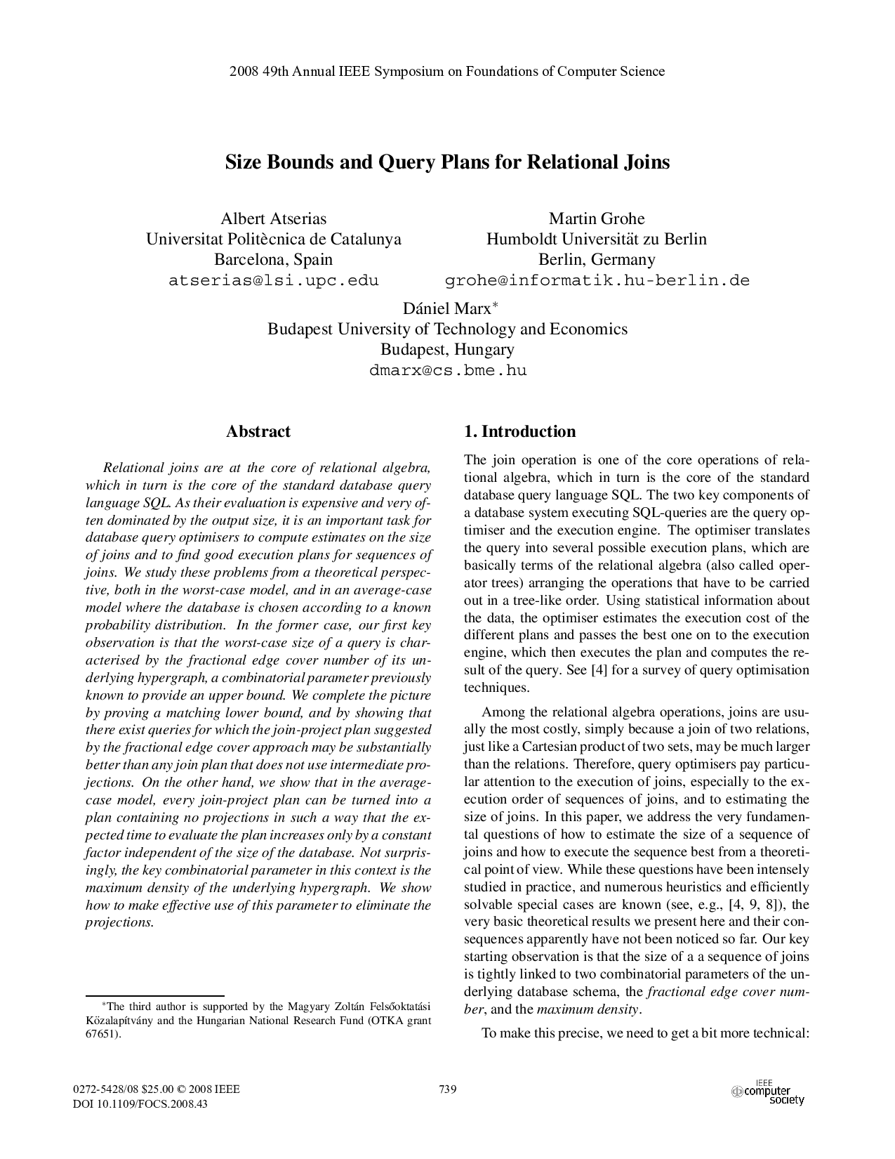
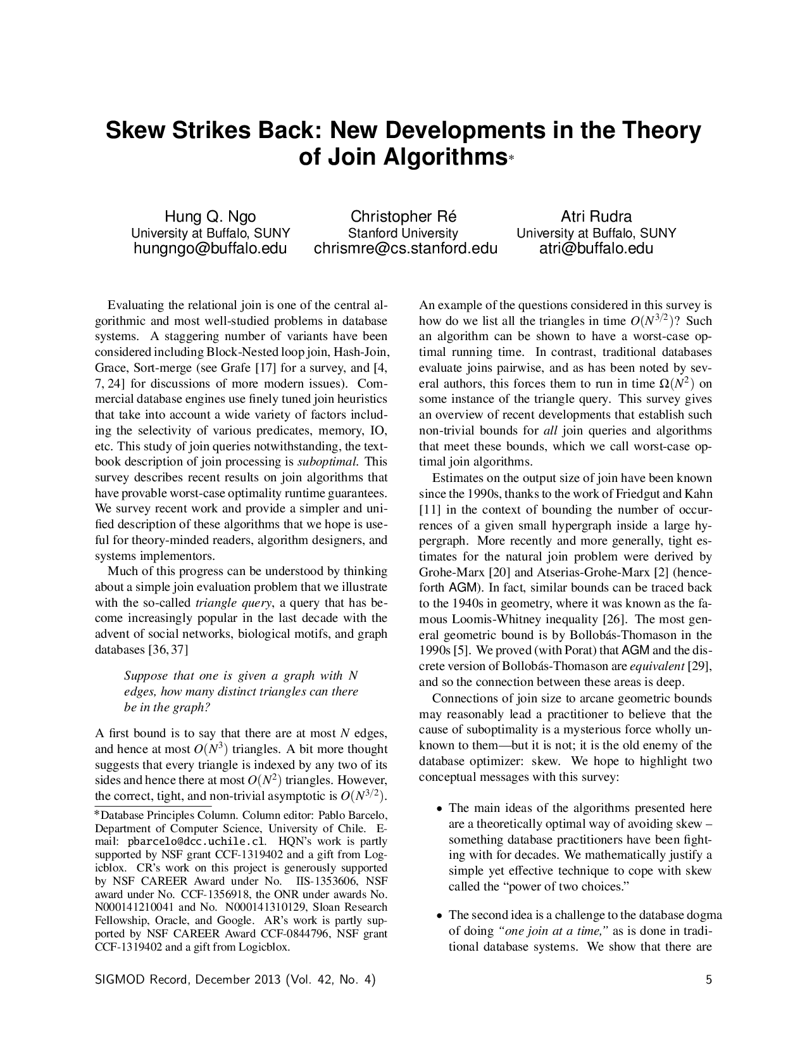
Complexity of the triangle query
For $m$edges, the AGM-bound of the triangle query is $𝒪\left(m^{3/2}\right)$
Theorem #1:
Any binary join plan for the triangle query takes $Ω\left(m^{2}\right)$ time.
To mitigate this, worst-case optimal join (WCOJ) algorithm use multi-way joins such as $⋈(A,B,C)$.
Theorem #2:
The worst-case complexity of the generic join algorithm (a WCOJ algorithm) $≤$ AGM bound.
A. Atserias, M. Grohe, D. Marx, Size Bounds and Query Plans for Relational Joins, FOCS 2008
H.Q. Ngo et al.: Skew strikes back: New developments in the theory of join algorithms, SIGMOD Record 2013

Slide 10
$$B$$
$$C$$
❶ | ② | ③ | ❹ | ⑤ | ⑥ | ❼ | ⑧ | ⑨
 |  |  |  |  |  | 1 | 1 | 1
 |  |  |  |  |  | 1
 |  |  |  |  |  | 1
$$j$$
 | ❶ | ② | ③ | ❹ | ⑤ | ⑥ | ❼ | ⑧ | ⑨
❶
②
③
❹ |  |  |  |  |  |  | 1 | 1 | 1
⑤ |  |  |  |  |  |  | 1
⑥ |  |  |  |  |  |  | 1
❼
⑧
⑨
❹
⑤
⑥
$$A$$
$$B$$
$$C$$
③
❼
②
⑧
$$i$$
$$k$$
❶
⑨
$$A$$
 | ❶ | ② | ③ | ❹ | ⑤ | ⑥ | ❼ | ⑧ | ⑨
❶ |  |  |  | 1 | 1 | 1
② |  |  |  | 1
③ |  |  |  | 1
❹
⑤
⑥
❼
⑧
⑨
❶ | ② | ③ | ❹ | ⑤ | ⑥ | ❼ | ⑧ | ⑨
 |  |  |  |  |  | 3 | 1 | 1
 |  |  |  |  |  | 1 | 1 | 1
 |  |  |  |  |  | 1 | 1 | 1
❶ | ② | ③ | ❹ | ⑤ | ⑥ | ❼ | ⑧ | ⑨
 |  |  |  |  |  | 3 | 1 | 1
 |  |  |  |  |  | 1
 |  |  |  |  |  | 1
5
1
1
$$A$$
$$A⊕.⊗B$$
$$A⊕.⊗B⊗C^{⊤}$$
$$tri$$

Slide 11
$$B$$
$$j$$
 | ❶ | ② | ③ | ❹ | ⑤ | ⑥ | ❼ | ⑧ | ⑨
❶
②
③
❹ |  |  |  |  |  |  | 1 | 1 | 1
⑤ |  |  |  |  |  |  | 1
⑥ |  |  |  |  |  |  | 1
❼
⑧
⑨
❹
⑤
⑥
$$A$$
$$B$$
$$C$$
③
❼
②
⑧
$$i$$
$$k$$
❶
⑨
$$A$$
 | ❶ | ② | ③ | ❹ | ⑤ | ⑥ | ❼ | ⑧ | ⑨
❶ |  |  |  | 1 | 1 | 1
② |  |  |  | 1
③ |  |  |  | 1
❹
⑤
⑥
❼
⑧
⑨
 |  |  |  |  |  | 3 | 1 | 1
 |  |  |  |  |  | 1
 |  |  |  |  |  | 1
5
1
1
$$tri$$
$$\left[⊕_{j}⋯\right]$$
$$A$$
$$\text{TRI}\left\langle C^{⊤}\right\rangle =A⊕.⊗B$$

Slide 12
Masking in relational algebra
Vertex-wise triangle count in linear algebra:
$$\text{TRI}\left\langle C^{⊤}\right\rangle =A⊕.⊗B$$
$$tri=\left[⊕_{j}TRI\left(:,j\right)\right]$$
Notice that in relational algebra, given $A\left(i,j\right), B\left(j,k\right), C\left(i,k\right)$:
$A⋈B⋈C≡\left(A⋈B\right)⋉C$
$A⋈B⋈C≡\left(B⋈C\right)⋈A≡\left(B⋈C\right)⋉A$
$A⋈B⋈C≡\left(A⋈C\right)⋈B≡\left(A⋈C\right)⋉B$
Where the semijoin operator $⋉$ is defined as:
$$R⋉S=π_{schema\left(R\right)}\left(R⋈S\right)=R⋈π_{schema\left(R\right)∩schema\left(S\right)}\left(S\right)$$

Slide 13
Triangle counting using relational ops.
Given relational schemas $A\left(i,j\right), B\left(j,k\right), C\left(i,k\right)$ and expression: $$A⋈B⋈C≡\left(A⋈B\right)⋉C$$
The “masking” technique cannot be translated to relational algebra as a single operation – we have to use an outside loop to express it. Using relation $TRI\left(i,k\right)$:
$\text{for} all c∈C do$
$TRI=TRI∪π_{i,k}\left(\left(A⋉\left\{c\right\}\right)⋈\left(B⋉\left\{c\right\}\right)\right)$
$tri=γ_{i,count\left(k\right)→triCount}\left(TRI\right)$
See also $\text{TRI}\left\langle C^{⊤}\right\rangle =A⊕.⊗B$, $tri=\left[⊕_{j}TRI\left(:,j\right)\right]$
$$i$$ | $$triCount$$
1 | 5
2 | 1
3 | 1

Slide 14
Triangle counting using relational ops.
Given relational schemas $A\left(i,j\right), B\left(j,k\right), C\left(i,k\right)$ and expression: $$A⋈B⋈C≡\left(A⋈B\right)⋉C$$
The “masking” technique cannot be translated to relational algebra as a single operation – we have to use an outside loop to express it. Using relation $TRI\left(i,k\right)$:
$\text{for} all \left\langle i^{′},k^{′}\right\rangle ∈C do$
$TRI=TRI∪π_{i,k}\left(\left(σ_{A.i=i^{′}}\left(A\right)\right)⋈\left(σ_{B.k=k^{′}}\left(B\right)\right)\right)$
$tri=γ_{i,count\left(k\right)→triCount}\left(TRI\right)$
See also $\text{TRI}\left\langle C^{⊤}\right\rangle =A⊕.⊗B$, $tri=\left[⊕_{j}TRI\left(:,j\right)\right]$
$$i$$ | $$triCount$$
1 | 5
2 | 1
3 | 1

Slide 15
Triangle enumeration
Relational algebra also allows triangle enumeration.
Given $A\left(i,j\right), B\left(j,k\right), C\left(i,k\right)$, instead of the previous expression:
$\text{for} all c∈C do$
$TRI=TRI∪π_{i,k}\left(\left(A⋉\left\{c\right\}\right)⋈\left(B⋉\left\{c\right\}\right)\right)$
$tri=γ_{i,count\left(k\right)→triCount}\left(TRI\right)$
Compute:
$\text{for} all c∈C do$
$TRI=TRI∪\left(\left(A⋉\left\{c\right\}\right)⋈\left(B⋉\left\{c\right\}\right)\right)$

Slide 16
Triangle enumeration in relational alg.
$\text{for} all c∈C do$
$TRI=TRI∪\left(\left(A⋉\left\{c\right\}\right)⋈\left(B⋉\left\{c\right\}\right)\right)$
$$C$$
$$k$$ | $$i$$
7 | 1
8 | 1
9 | 1
7 | 2
7 | 3
$$A$$
$$i$$ | $$j$$
1 | 4
2 | 4
3 | 4
1 | 5
1 | 6
$$B$$
$$j$$ | $$k$$
4 | 7
4 | 8
4 | 9
5 | 7
6 | 7
$$A⋈B⋈C$$
$$i$$ | $$j$$ | $$k$$
1 | 4 | 7
1 | 5 | 7
1 | 6 | 7
1 | 4 | 8
1 | 4 | 9
2 | 4 | 7
3 | 4 | 7
$$A⋉\left\{c\right\}$$
$$B⋉\left\{c\right\}$$

Slide 17
Triangle enumeration in relational alg.
$\text{for} all c∈C do$
$TRI=TRI∪\left(\left(A⋉\left\{c\right\}\right)⋈\left(B⋉\left\{c\right\}\right)\right)$
$$C$$
$$k$$ | $$i$$
7 | 1
8 | 1
9 | 1
7 | 2
7 | 3
$$A$$
$$i$$ | $$j$$
1 | 4
2 | 4
3 | 4
1 | 5
1 | 6
$$B$$
$$j$$ | $$k$$
4 | 7
4 | 8
4 | 9
5 | 7
6 | 7
$$A⋈B⋈C$$
$$i$$ | $$j$$ | $$k$$
1 | 4 | 7
1 | 5 | 7
1 | 6 | 7
1 | 4 | 8
1 | 4 | 9
2 | 4 | 7
3 | 4 | 7
$$A⋉\left\{c\right\}$$
$$B⋉\left\{c\right\}$$

Slide 18
Triangle enumeration in relational alg.
$\text{for} all c∈C do$
$TRI=TRI∪\left(\left(A⋉\left\{c\right\}\right)⋈\left(B⋉\left\{c\right\}\right)\right)$
$$C$$
$$k$$ | $$i$$
7 | 1
8 | 1
9 | 1
7 | 2
7 | 3
$$A$$
$$i$$ | $$j$$
1 | 4
2 | 4
3 | 4
1 | 5
1 | 6
$$B$$
$$j$$ | $$k$$
4 | 7
4 | 8
4 | 9
5 | 7
6 | 7
$$A⋈B⋈C$$
$$i$$ | $$j$$ | $$k$$
1 | 4 | 7
1 | 5 | 7
1 | 6 | 7
1 | 4 | 8
1 | 4 | 9
2 | 4 | 7
3 | 4 | 7
$$A⋉\left\{c\right\}$$
$$B⋉\left\{c\right\}$$

Slide 19
Triangle enumeration in relational alg.
$\text{for} all c∈C do$
$TRI=TRI∪\left(\left(A⋉\left\{c\right\}\right)⋈\left(B⋉\left\{c\right\}\right)\right)$
$$C$$
$$k$$ | $$i$$
7 | 1
8 | 1
9 | 1
7 | 2
7 | 3
$$A$$
$$i$$ | $$j$$
1 | 4
2 | 4
3 | 4
1 | 5
1 | 6
$$B$$
$$j$$ | $$k$$
4 | 7
4 | 8
4 | 9
5 | 7
6 | 7
$$A⋈B⋈C$$
$$i$$ | $$j$$ | $$k$$
1 | 4 | 7
1 | 5 | 7
1 | 6 | 7
1 | 4 | 8
1 | 4 | 9
2 | 4 | 7
3 | 4 | 7
$$A⋉\left\{c\right\}$$
$$B⋉\left\{c\right\}$$

Slide 20
Triangle enumeration in relational alg.
$\text{for} all c∈C do$
$TRI=TRI∪\left(\left(A⋉\left\{c\right\}\right)⋈\left(B⋉\left\{c\right\}\right)\right)$
$$C$$
$$k$$ | $$i$$
7 | 1
8 | 1
9 | 1
7 | 2
7 | 3
$$A$$
$$i$$ | $$j$$
1 | 4
2 | 4
3 | 4
1 | 5
1 | 6
$$B$$
$$j$$ | $$k$$
4 | 7
4 | 8
4 | 9
5 | 7
6 | 7
$$A⋈B⋈C$$
$$i$$ | $$j$$ | $$k$$
1 | 4 | 7
1 | 5 | 7
1 | 6 | 7
1 | 4 | 8
1 | 4 | 9
2 | 4 | 7
3 | 4 | 7
$$A⋉\left\{c\right\}$$
$$B⋉\left\{c\right\}$$

Slide 21
Triangle enumeration in relational alg.
$\text{for} all c∈C do$
$TRI=TRI∪\left(\left(A⋉\left\{c\right\}\right)⋈\left(B⋉\left\{c\right\}\right)\right)$
$$C$$
$$k$$ | $$i$$
7 | 1
8 | 1
9 | 1
7 | 2
7 | 3
$$A$$
$$i$$ | $$j$$
1 | 4
2 | 4
3 | 4
1 | 5
1 | 6
$$B$$
$$j$$ | $$k$$
4 | 7
4 | 8
4 | 9
5 | 7
6 | 7
$$A⋈B⋈C$$
$$i$$ | $$j$$ | $$k$$
1 | 4 | 7
1 | 5 | 7
1 | 6 | 7
1 | 4 | 8
1 | 4 | 9
2 | 4 | 7
3 | 4 | 7
$$A⋉\left\{c\right\}$$
$$B⋉\left\{c\right\}$$
Using semijoin pushdown on each tuple, we computed $A⋈B⋈C$ without enumerating a quadratic-size interim relation. However, for efficient implementations, relations should also be sorted (see ref. for details).
H.Q. Ngo et al.: Skew strikes back: New developments in the theory of join algorithms, SIGMOD Record 2013

Slide 22
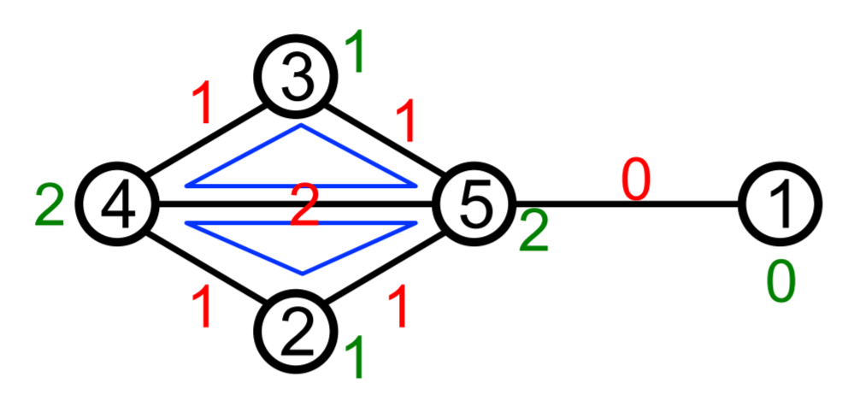
triangle enumeration in linear algebra
(Note that this work is yet to be ported to GraphBLAS.)
Triangle enumeration is possible by using triples as matrix elements and overloading “$⊕.⊗$” so that multiplying the adjacency matrix $A$ with the incidence matrix $B$ results in $C$:
$C\left(i,j\right)=\left(i,x,y\right) \text{iff} A\left(i,x\right)=A\left(i,y\right)=1 \text{and} B\left(x,j\right)=B\left(y,j\right)=1$
M.M. Wolf et al. A task-based linear algebra building blocks approach for scalable graph analytics, HPEC 2015

Slide 23
Generic join
TODO: describe the generic join algorithm
Theorem #2:
The worst-case complexity of the generic join algorithm (a WCOJ algorithm) $≤$ AGM bound.

Slide 24
matrix multiplication in relational alg.
 | set | $$⨁$$ | $$⨂$$ | 0
set relations | $$R⊆D_{1}×…×D_{k}$$ | $$∪$$ | $$⋈$$ | empty rel.
matrix relations | $$R⊆D_{1}×D_{2}$$ | $$∪$$ | $$⊠$$ | empty rel.
Observations:
a binary relation is analogous to a Boolean sparse matrix stored in coordinate list (COO) format
a matrix multiplication is analogous to an equijoin on a binary relation that uses a single join attribute, and discards it after performing the join.
Definition: Given two binary relations $R,S$ with a common attribute $x$, we define “multjoin” as :
$$R⊠S=π_{R∪S∖\left\{x\right\}}\left(R\underset{R.x=S.x}{⋈}S\right)$$
Example:
$$A$$
$$i$$ | $$j$$
1 | 3
1 | 4
2 | 4
$$B$$
$$j$$ | $$k$$
4 | 6
4 | 7
5 | 7
$$A⊠B$$
$$i$$ | $$k$$
1 | 6
1 | 7
2 | 6
2 | 7
Notes:
Bag relations can form a ring if the bags are allowed to have a multiplicity from Z.

Slide 25
MM Vs. multJOIN: reachability
Matrices: Relations:
$A∈𝔹^{m×n}$, $B∈𝔹^{n×o}$, $C∈𝔹^{o×p}$ $A\left(i,j\right)$, $B\left(j,k\right)\text{,}$ $C(k,l)$
For $A∨.∧B$: ${\left\langle AB\right\rangle }_{ik}= \underset{k}{∨}\left(A_{ij}∧B_{jk}\right)$ $A⊠B$ sch: $(i,k)$
For $A∨.∧B∨.∧C$: $A⊠B⊠C$ sch: $(i,l)$
${\left\langle ABC\right\rangle }_{il}=$ $= \underset{k}{∨}\left({\left\langle AB\right\rangle }_{ik}∧C_{kl}\right)$ $= \underset{k}{∨}\left(\underset{j}{∨}\left(A_{ij}∧B_{jk}\right)\right)∧C_{kl}$ $= \underset{k}{∨}\left(\underset{j}{∨}\left(A_{ij}∧B_{jk}∧C_{kl}\right)\right)$
$$B$$ |  | $$k$$
$$↓j$$
$$C$$ |  |  |  | $$l$$
$$↓k$$
$$A$$ |  |  | $$→j$$
$$i$$
$$AB$$
$$AB$$ |  | $$→k$$
$i$
$$ABC$$
Notes:
Nested loop
Double nested loop

Slide 26
MM Vs. JOIN: Counting paths
Matrices:
$A∈ℕ^{m×n}$, $B∈ℕ^{n×o}$, $C∈ℕ^{o×p}$
$${\left\langle AB\right\rangle }_{ik}=\underset{j}{Σ} A_{ij}⊗B_{jk}$$
$${\left\langle ABC\right\rangle }_{il}=\underset{k}{Σ}\left({\underset{j}{Σ} A}_{ij}⊗B_{jk}\right)⊗C_{kl} \\ =\underset{k}{Σ}\left({\underset{j}{Σ} A}_{ij}⊗B_{jk}⊗C_{kl}\right)$$
Relations: $A\left(i,j,va\right)$, $B\left(j,k,vb\right)\text{,}$ $C(k,l,vc)$
$$γ_{sum(A_{va}⋅B_{vb})}^{A.i,B.k}\left(A⋈B\right)$$
$γ_{sum(A_{va}⋅B_{vb}⋅C_{vc})}^{A.i,C.l}\left(A⋈B⋈C\right)$
Enumerating triangles requires applying $σ_{A.i=C.l}\left(…\right)$
Notes:
Nested loop
Double nested loop

Slide 27
Matrix multiplication in SQL: Paths
$${\left\langle AB\right\rangle }_{ik}=\underset{j}{Σ} A_{ij}⊗B_{jk}⇒γ_{Σ(A_{va}⋅B_{vb})}^{A.i,B.k}\left(A⋈B\right)$$
select A.i, B.k, sum(A.va * B.vb) from A, B where A.j = B.j group by A.i, B.k;
$${\left\langle ABC\right\rangle }_{il}=\underset{k}{Σ}\left({\underset{j}{Σ} A}_{ij}⊗B_{jk}⊗C_{kl}\right)⇒γ_{Σ(A_{va}⋅B_{vb}⋅C_{vc})}^{A.i,C.l}\left(A⋈B⋈C\right)$$
select A.i, C.l, sum(A.va * B.vb * C.vc) from A, B, C where A.j = B.j and B.k = C.k group by A.i, C.l;

Slide 28
Matrix multiplication in SQL: triangles
Relations $A\left(i,j,va\right)$, $B\left(j,k,vb\right)\text{,}$ $C(k,l,vc)$
$${\left\langle ABC\right\rangle }_{ii}=\underset{k}{Σ}\left({\underset{j}{Σ} A}_{ij}⊗B_{jk}⊗C_{kl}\right)⇒γ_{Σ(A_{va}⋅B_{vb}⋅C_{vc})}^{A.i,C.l}\left(σ_{A.i=C.l}\left(A⋈B⋈C\right)\right)$$
select A.i, C.l, sum(A.va * B.vb * C.vc) from A, B, C where A.j = B.j and B.k = C.k
and A.i = C.l group by A.i, C.l;
Given relations $A\left(i,j,va\right)$, $B\left(j,k,vb\right)\text{,}$ $C(i,k,vc)$, we can simply use two natural joins: $A⋈B⋈C$.

