Slide 1
Introduction to GraphBLAS
Case studies
Gábor Szárnyas
szarnyas@mit.bme.hu

Slide 2
Colour coding for traversals
The colours are encoded in the PowerPoint template to make them easy to change.
Level 1: 
Level 2: 
Level 3: 
Level 4: 
Level n: 
TODO: come up with a consistent style for animations (step-by-step or slide at once)

Slide 3
Graph benchmarks

Slide 4
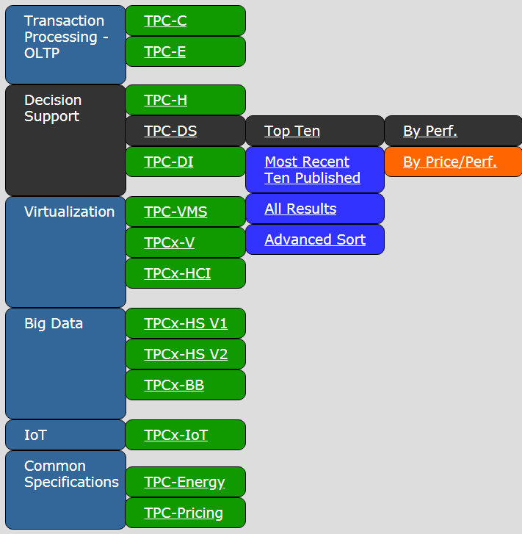
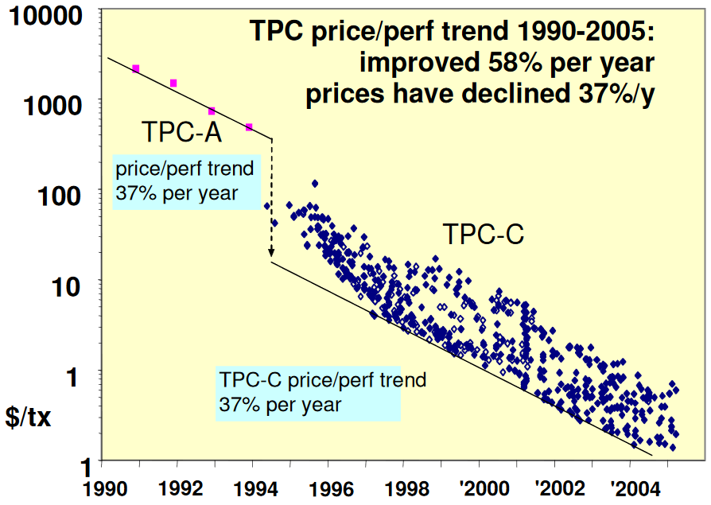
TPC: Transaction Processing Performance Council
Standard specifications for benchmarking certain aspects of relational DBs

Slide 5
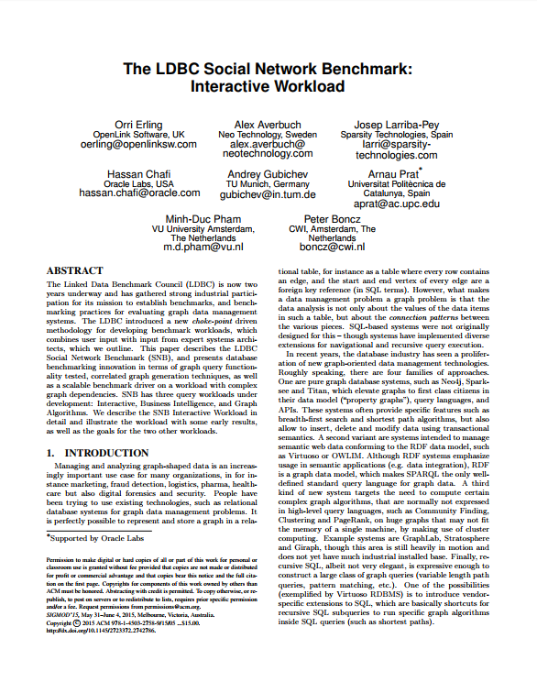
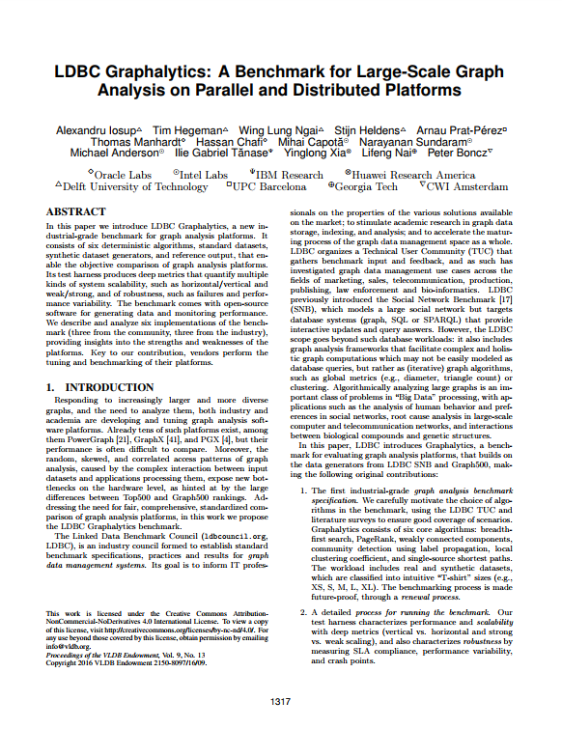
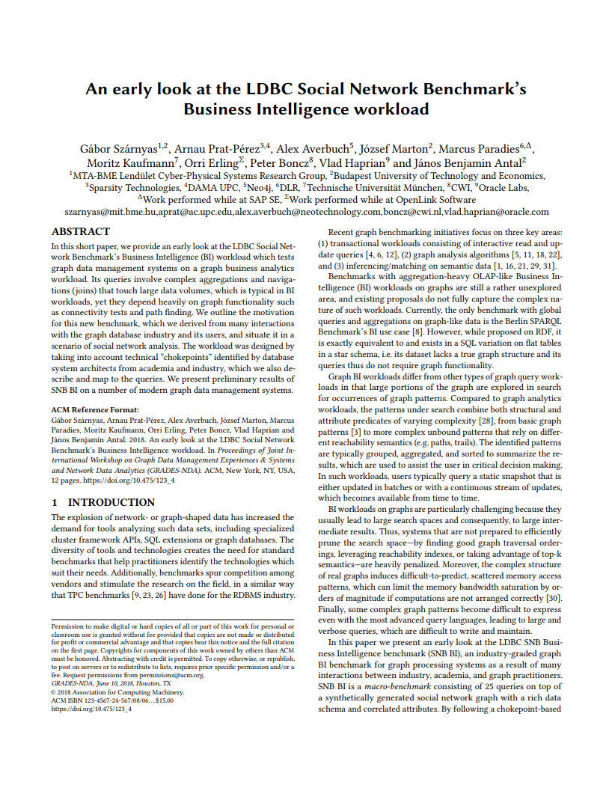
LDBC: Linked Data Benchmark Council
A non-profit academic & industrial organization
Dedicated to define standard benchmarks for graph databases
EU FP7 project — Community meetings — Benchmark papers
2012
2013
2014
2015
2016
2017
2018
2019
2020
1
2
3
4
5
6
7
8
9
10
11
12
13
Social Network Benchmark
Interactive workload SIGMOD 2015 Erling et al.
SNB Business Intelligence
GRADES@SIGMOD 2018 Szárnyas et al.
Graphalytics
VLDB 2016, Iosup et al.

Slide 6
Graph processing categories in LDBC
graph queries: structure, types, and properties
graph analytics: structure only
OLAP: SNB BI
expected execution time
$$≈𝒪\left(n\log{n} \right)$$
Graphalytics
$$≈𝒪\left(d⋅log{n}\right)$$
OLTP:
SNB Int.
$$≈𝒪\left(n+e\right)$$
portion of the graph accessed

Slide 7
Preliminary results with SuiteSparse:GB
graph500-26 33M vertices, 1.1B edges
Twitter 50M vertices, 2B edges
d-8.8-zf 168M vertices, 413M edges
d-8.6-fb 6M vertices, 422M edges
Ubuntu Server, 512 GB RAM, 64 CPU cores, 128 threads
loading often takes longer than processing
Notes:
Setup: network-attached HDD storage (100 mbyte/s), 512 GBs of RAM and dual AMD EPYC 7551 CPUs (64 cores, 128 threads in total).

Slide 8
The GAP benchmark suite
Part of the Berkeley Graph Algorithm Platform project
Same authors as the direction-optimizing BFS algorithm
Six algorithms: BFS, SSSP, PageRank, connected components, betweenness centrality, triangle count
Five data sets: Twitter, Web, Road, Kron, Urand
24M to 134M vertices, 68M to 2.1B edges
Weighted/unweighted, directed/undirected
Very efficient baseline implementation in C++
Maintained on arXiv – v1: 2015, …, v4: 2017
S. Beamer, K. Asanovic, D. Patterson: The GAP Benchmark Suite, arXiv, 2017
gap.cs.berkeley.edu/benchmark.html

Slide 9
SuiteSparse:GraphBLAS and GAP
TODO: IISWC paper

Slide 10
Case study: SIGMOD 2014 Contest
Overview

Slide 11
SIGMOD 2014 Programming Contest
Annual contest
Teams compete on database-related programming tasks
Highly-optimized C++ implementations
2014 event
Tasks on the LDBC social network graph
Benchmark data set for property graphs
People, forums, comments, hashtags, etc.
4 queries
Mix of filtering operations and graph algorithms

Slide 12
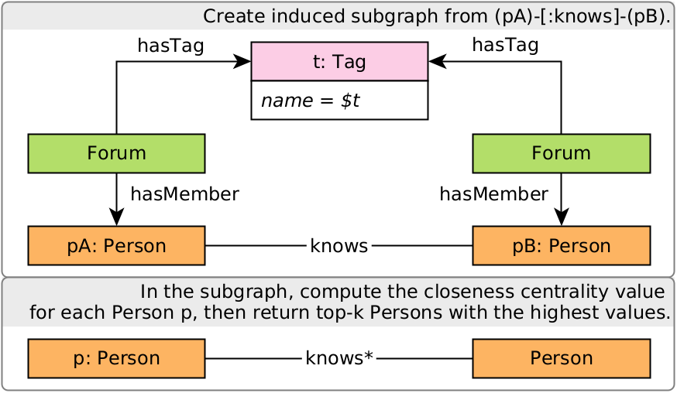
Query template
Compute an induced subgraph over Person-knows-Person
Run the graph algorithm on the subgraph
I.
0.67
0.80
II.
0.67
0.67
0.80
exact closeness centrality
key kernel: all-source BFS

Slide 13
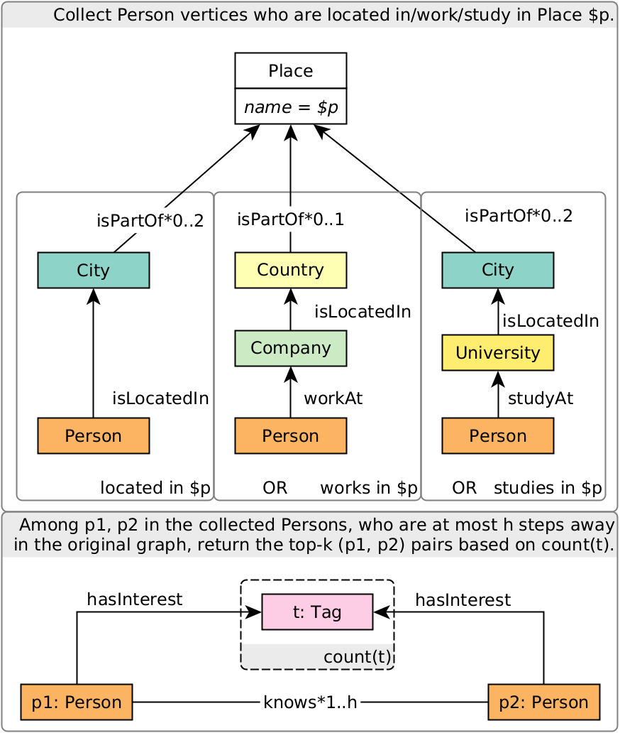
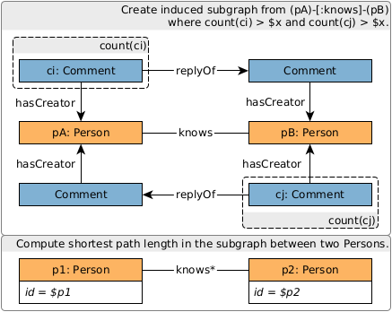
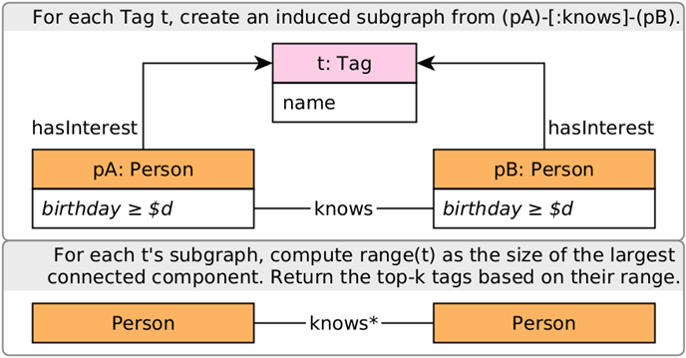
Overview of Queries 1, 2, 3
I. Filter the induced subgraph(s)
II. Run the graph algorithm
unweighted shortest path
connected components
pairwise reachability

Slide 14
Q1

Slide 15
Q2

Slide 16
Q3

Slide 17
Q4

Slide 18
GraphBLAS solution of the queries
Loading includes relabelling UINT64 vertex IDs to a contiguous sequence $0…N−1$.
Filtering the induced subgraph from the property graph is mostly straightforward and composable with the algorithms.
The algorithms can be concisely expressed in GraphBLAS:
Connected components ✓ → FastSV [Zhang et al., PPSC’20]
BFS ✓
Bidirectional BFS
All-source BFS + bitwise optimization
Multi-source bidirectional BFS
Notes:
Exact closeness centrality value
Geodesics can be determined with multi-source BFS
Optimizations

Slide 19
Case study: SIGMOD 2014 Contest
BFS

Slide 20
BFS: Breadth-First SEARCH
$frontier$
①. | ●
②.
③.
④.
⑤.
1
2
Boolean matrices and vectors
5
4
3
$\left\langle ¬seen\right\rangle$ mask
$seen$
①. | ●
②.
③.
④.
⑤.
$A$ | ① | ② | ③ | ④ | ⑤
① |  | ● |  | ●
② | ● |  | ● |  | ●
③ |  | ● |  | ● | ●
④ | ● |  | ●
⑤ |  | ● | ●
$⊕$: logical OR $⊗$: logical AND
$$next\left\langle ¬seen\right\rangle = \\ A any .pair frontier$$

Slide 21
BFS: Breadth-First SEARCH
$frontier$
①. | ●
②.
③.
④.
⑤.
1
2
5
4
3
$seen$
①. | ●
②.
③.
④.
⑤.
$A$ | ① | ② | ③ | ④ | ⑤
① |  | ● |  | ●
② | ● |  | ● |  | ●
③ |  | ● |  | ● | ●
④ | ● |  | ●
⑤ |  | ● | ●
 | ●
 | ●
$seen′$
①. | ●
②. | ●
③.
④. | ●
⑤.
$$next\left\langle ¬seen\right\rangle = \\ A any .pair frontier$$
$$seen^{′}=$$ $seen any next$

Slide 22
BFS: Breadth-First SEARCH
$frontier$
①.
②. | ●
③.
④. | ●
⑤.
1
2
5
mask prevents redundant computations
4
3
$seen$
①. | ●
②. | ●
③.
④. | ●
⑤.
$A$ | ① | ② | ③ | ④ | ⑤
① |  | ● |  | ●
② | ● |  | ● |  | ●
③ |  | ● |  | ● | ●
④ | ● |  | ●
⑤ |  | ● | ●
 | ●
 | ●
$seen′$
①. | ●
②. | ●
③. | ●
④. | ●
⑤. | ●
$$next\left\langle ¬seen\right\rangle = \\ A any . pair frontier$$
$$seen^{′}=$$ $seen any next$

Slide 23
Case study: SIGMOD 2014 Contest
All-source BFS

Slide 24
Q4: Closeness centrality valueS
Q4 computes the top-k Person vertices based on their exact closeness centrality values:
$$CCV\left(p\right)=\frac{{\left(C\left(p\right)−1\right)}^{2}}{\left(n−1\right)⋅s\left(p\right)}$$
where
$C\left(p\right)$ is the size of the connected component of vertex $p$,
$n$ is the number of vertices in the induced graph,
$s\left(p\right)$ is the sum of geodesic distances to all other reachable persons from $p$.
$s\left(p\right)$ is challenging: needs unweighted all-pairs shortest paths.

Slide 25
Boolean All-Source BFS algorithm
traversals
$Frontier$ | t1 | t2 | t3 | t4 | t5
①. | ●
②. |  | ●
③. |  |  | ●
④. |  |  |  | ●
⑤. |  |  |  |  | ●
1
2
5
4
3
$$Seen$$ | t1 | t2 | t3 | t4 | t5
①. | ●
②. |  | ●
③. |  |  | ●
④. |  |  |  | ●
⑤. |  |  |  |  | ●
$A$ | ① | ② | ③ | ④ | ⑤
① |  | ● |  | ●
② | ● |  | ● |  | ●
③ |  | ● |  | ● | ●
④ | ● |  | ●
⑤ |  | ● | ●
 | ● |  | ●
● |  | ● |  | ●
 | ● |  | ● | ●
● |  | ●
 | ● | ●
$$Seen′$$ | t1 | t2 | t3 | t4 | t5
①. | ● | ● |  | ●
②. | ● | ● | ● |  | ●
③. |  | ● | ● | ● | ●
④. | ● |  | ● | ●
⑤. |  | ● | ● |  | ●
$$Next\left\langle ¬Seen\right\rangle =$$ $A any .pair Frontier$
$$Seen^{′}=$$ $Seen any Next$

Slide 26
Boolean All-Source BFS algorithm
$Frontier$ | t1 | t2 | t3 | t4 | t5
①. |  | ● |  | ●
②. | ● |  | ● |  | ●
③. |  | ● |  | ● | ●
④. | ● |  | ●
⑤. |  | ● | ●
1
2
5
4
3
$$Seen$$ | t1 | t2 | t3 | t4 | t5
①. | ● | ● |  | ●
②. | ● | ● | ● |  | ●
③. |  | ● | ● | ● | ●
④. | ● |  | ● | ●
⑤. |  | ● | ● |  | ●
$A$ | ① | ② | ③ | ④ | ⑤
① |  | ● |  | ●
② | ● |  | ● |  | ●
③ |  | ● |  | ● | ●
④ | ● |  | ●
⑤ |  | ● | ●
 |  | ● |  | ●
 |  |  | ●
●
 | ● |  |  | ●
● |  |  | ●
$$Seen′$$ | t1 | t2 | t3 | t4 | t5
①. | ● | ● | ● | ● | ●
②. | ● | ● | ● | ● | ●
③. | ● | ● | ● | ● | ●
④. | ● | ● | ● | ● | ●
⑤. | ● | ● | ● | ● | ●
$$Next\left\langle ¬Seen\right\rangle =$$ $A any .pair Frontier$
$$Seen^{′}=$$ $Seen any Next$

Slide 27
Case study: SIGMOD 2014 Contest
Bitwise all-source BFS

Slide 28
Bitwise all-source bfs algorithm
For large graphs, the all-source BFS algorithm might need to run 500k+ traversals
Two top-ranking teams used bitwise operations to process traversals in batches of 64 [Then et al., VLDB’15]
This idea can be adopted in the GraphBLAS algorithm by
using UINT64 values
performing the multiplication on the $BOR . SECOND$ semiring, where $BOR$ is “bitwise or” and $SECOND\left(x,y\right)=y$
5-10x speedup compared to the Boolean all-source BFS

Slide 29
Bitwise All-source BFS algorithm
Using UINT4s here
$Frontier$ | t1-t4 | t5
①. | 1000 | 0000
②. | 0100 | 0000
③. | 0010 | 0000
④. | 0001 | 0000
⑤. | 0000 | 1000
1
2
5
4
3
$$Seen$$ | t1-t4 | t5
①. | 1000 | 0000
②. | 0100 | 0000
③. | 0010 | 0000
④. | 0001 | 0000
⑤. | 0000 | 1000
$A$ | ① | ② | ③ | ④ | ⑤
① |  | ● |  | ●
② | ● |  | ● |  | ●
③ |  | ● |  | ● | ●
④ | ● |  | ●
⑤ |  | ● | ●
0101 | 0000
1010 | 1000
0101 | 1000
1010 | 0000
0110 | 0000
$$Seen′$$ | t1-t4 | t5
①. | 0101 | 0000
②. | 1010 | 1000
③. | 0101 | 1000
④. | 1010 | 0000
⑤. | 0110 | 0000
$$Next=$$ $A bor .second Frontier$
$$Seen^{′}=$$ $Seen bor Next$

Slide 30
Bitwise All-Source BFS algorithm
$Frontier$ | t1-t4 | t5
①. | 0101 | 0000
②. | 1010 | 1000
③. | 0101 | 1000
④. | 1010 | 0000
⑤. | 0110 | 0000
Full VLDB paper on this algorithm
vs.
9 GrB operations
1
2
5
4
3
$$Seen$$ | t1-t4 | t5
①. | 0101 | 0000
②. | 1010 | 1000
③. | 0101 | 1000
④. | 1010 | 0000
⑤. | 0110 | 0000
$A$ | ① | ② | ③ | ④ | ⑤
① |  | ● |  | ●
② | ● |  | ● |  | ●
③ |  | ● |  | ● | ●
④ | ● |  | ●
⑤ |  | ● | ●
0010 | 1000
0001 | 0000
1000 | 0000
0100 | 1000
1001 | 0000
$$Seen′$$ | t1-t4 | t5
①. | 1111 | 1000
②. | 1111 | 1000
③. | 1111 | 1000
④. | 1111 | 1000
⑤. | 1111 | 1000
$$Next=$$ $A bor .second Frontier$
$$Seen^{′}=$$ $Seen bor Next$

Slide 31
Case study: SIGMOD 2014 Contest
Bidirectional BFS

Slide 32
Bidirectional BFS
Advance frontiers alternately and intersect them
Length = 1 ✗
$$next1 land frontier2$$
$frontier1$
①. | ●
②.
③.
④.
⑤.
$frontier$2
①.
②.
③.
④.
⑤. | ●
 | ●
 | ●
 | ●
1
2
1
2
$$=$$
5
5
$$∧$$
4
3
4
3
$A$ | ① | ② | ③ | ④ | ⑤
① |  | ● |  | ●
② | ● |  | ● |  | ●
③ |  | ● |  | ● | ●
④ | ● |  | ●
⑤ |  | ● | ●
 | ●
 | ●
$A$ | ① | ② | ③ | ④ | ⑤
① |  | ● |  | ●
② | ● |  | ● |  | ●
③ |  | ● |  | ● | ●
④ | ● |  | ●
⑤ |  | ● | ●
 | ●
 | ●
 | ●
 | ●
 | ●
 | ●
 | ●
$$∧$$
$$=$$
$$next1$$
$$next2$$
Length = 2 ✓
$$next1 land next2$$

Slide 33
Case study: SIGMOD 2014 Contest
Bidirectional MSBFS

Slide 34
Bidirectional MSBFS algorithm
Pairwise reachability problem: From a given set of $k$ vertices, which pairs of vertices are reachable from each other with at most $h$ hops?
Naïve solution: Run a $k$-source MSBFS for $h$ steps and check reachability. The frontiers get large as they grow exponentially.
Better solution: Advance all frontiers simultaneously for $\left\lceil h/2\right\rceil$ iterations.
5
1
3
6
2
4

Slide 35
Bidirectional MSBFS
$$A$$ | ① | ② | ③ | ④ | ⑤ | ⑥
① |  | ●
② | ● |  | ●
③ |  | ● |  | ● | ●
④ |  |  | ● |  | ● | ●
⑤ |  |  | ● | ●
⑥ |  |  |  | ●
$$S[0]$$ | ① | ② | ③ | ④ | ⑤ | ⑥
① | ●
②
③
④
⑤ |  |  |  |  | ●
⑥ |  |  |  |  |  | ●
$Seen\left[1\right]:$ reachability with ≤ 1 hops
5
1
2
3
6
4
$$F$$ | ① | ② | ③ | ④ | ⑤ | ⑥
① | ●
②
③
④
⑤ |  |  |  |  | ●
⑥ |  |  |  |  |  | ●
 |  | ●
 |  |  | ● | ●
 |  |  |  | ●
① | ● | ●
②
③
④
⑤ |  |  | ● | ● | ●
⑥ |  |  |  | ● |  | ●
$$Next[1]$$
$$Seen[1]$$

Slide 36
Bidirectional MSBFS
$$A$$ | ① | ② | ③ | ④ | ⑤ | ⑥
① |  | ●
② | ● |  | ●
③ |  | ● |  | ● | ●
④ |  |  | ● |  | ● | ●
⑤ |  |  | ● | ●
⑥ |  |  |  | ●
$$S[1]$$ | ① | ② | ③ | ④ | ⑤ | ⑥
① | ● | ●
②
③
④
⑤ |  |  | ● | ● | ●
⑥ |  |  |  | ● |  | ●
$Seen\left[2\right]:$ reachability with ≤ 2 hops
5
1
2
3
6
4
$$F$$ | ① | ② | ③ | ④ | ⑤ | ⑥
① |  | ●
②
③
④
⑤ |  |  | ● | ●
⑥ |  |  |  | ●
 |  |  | ●
 |  |  | ●
① | ● | ● | ●
②
③
④
⑤ |  |  | ● | ● | ●
⑥ |  |  | ● | ● |  | ●
$$Next[2]\left\langle Seen\left[1\right]\right\rangle$$
$$Seen[2]$$

Slide 37
Bidirectional MSBFS: paths of length ≤ 4
$$Seen{\left[2\right]}^{⊤}$$
 | ① | ② | ③ | ④ | ⑤ | ⑥
① | ●
② | ●
③ | ● |  |  |  | ● | ●
④ |  |  |  |  | ● | ●
⑤ |  |  |  |  | ●
⑥ |  |  |  |  |  | ●
From vertex 1, we could get to these vertices with ≤ 2 hops
5
1
2
3
6
To get paths of at most 4 hops, we compute
$$Seen\text{[}\text{2}\text{] }\text{any}\text{.}\text{pair} Seen{\left[2\right]}^{⊤}$$
Here, we found paths between all pairs:
from ① to ⑤,
from ① to ⑥,
from ⑤ to ⑥.
4
$Seen$[2]
 | ① | ② | ③ | ④ | ⑤ | ⑥
① | ● | ● | ●
②
③
④
⑤ |  |  | ● | ● | ●
⑥ |  |  | ● | ● |  | ●
 |  |  |  |  | ● | ●
 | ● |  |  |  |  | ●
 | ● |  |  |  | ●
From vertex 5, we could get to these vertices with ≤ 2 hops

Slide 38
Bidirectional MSBFS: paths of length = 3
$$Next{\left[2\right]}^{⊤}$$
 | ① | ② | ③ | ④ | ⑤ | ⑥
①
②
③ | ● |  |  |  |  | ●
④
⑤
⑥
From vertex 1, we could get to this vertex with 2 hops
5
1
2
3
6
4
To get exactly 3-length paths we compute
$$Next\text{[}\text{1}\text{]} \text{any}\text{.}\text{pair} Next{\left[2\right]}^{⊤}$$
We found two 3-length paths:
from ⑤ to ①
from ⑤ to ⑥.
$$Next\text{[}\text{1}\text{] }$$
 | ① | ② | ③ | ④ | ⑤ | ⑥
① |  | ●
②
③
④
⑤ |  |  | ● | ●
⑥ |  |  |  | ●
 | ● |  |  |  |  | ●
From vertex 5, we could get to these vertices with 1 hop

Slide 39
Case study: SIGMOD 2014 Contest
Results

Slide 40
Benchmark Results
The top solution of AWFY vs. SuiteSparse:GraphBLAS v3.3.3
AWFY’s solution uses SIMD instructions → difficult to port
GraphBLAS load times are slow (see details in paper)
Outliers
80 executions with different parameters
Notes:
Query times: Q1 – slow, Q2 – fast, Q3 – okay, Q4 – varied

Slide 41
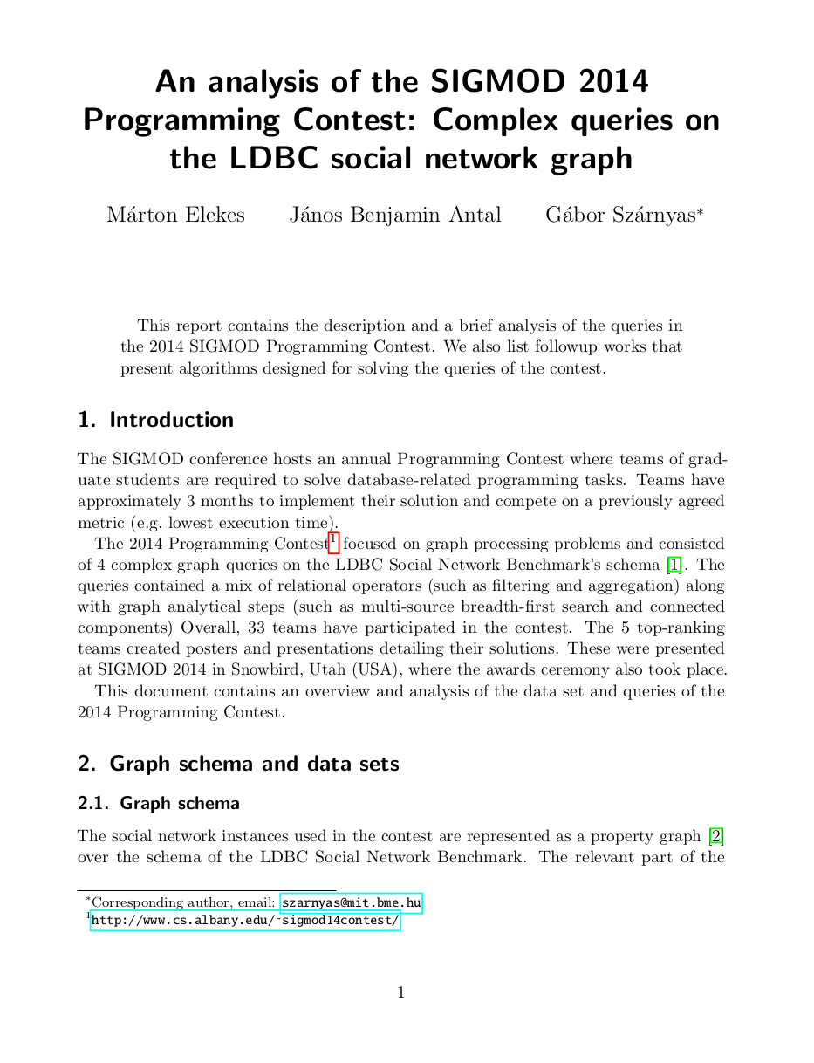
Summary
An interesting case study, see technical report
GraphBLAS can capture mixed workloads
Induced subgraph computations are simple to express
Algorithms are concise, bitwise optimizations can be adopted
Performance is sometimes on par with specialized solutions
Future optimizations
Bitmap-based matrix/vector compression is WIP by Tim Davis → ≈5× speedup without using bitwise operators in our code
Extended slide deck
GraphBLAS
sigmod2014-contest-graphblas

Slide 42
SIGMOD 2014 Programming Contest
Useful case study
Interesting mix of queries and algorithms
Realistic graph data sets
Easy to create an initial solution
Strong baseline implementations
Detailed specification: technical report
Illustration and analysis of queries
Discussion on caveats and corner cases

