Slide 1
Introduction to GraphBLAS
Algorithms
Gábor Szárnyas
szarnyas@mit.bme.hu

Slide 2
Graph algorithms in GraphBLAS
PageRank

Slide 3
PageRank – definition (LDBC graphalytics)
We use one of the simpler definitions. For $k=1$ to $t$ iterations:
${\text{PR}}_{0}\left(v\right)=\frac{1}{n}$
$${\text{PR}}_{k}\left(v\right)=\frac{1−α}{n} + α⋅\sum_{u∈N_{in}\left(v\right)}{\frac{{\text{PR}}_{k−1}\left(u\right)}{\left|N_{out}\left(u\right)\right|}} + \frac{α}{n}⋅\sum_{w∈dng}{{\text{PR}}_{k−1}\left(w\right)}$$
$α$: damping factor
$dng$: dangling vertices,$dng=\left\{w∈V | \left|N_{out }\left(w\right)\right|=0\right\}$
There are dozens of PR definitions, some treat dangling vertices differently.
teleport
influence
dangling

Slide 4
PageRank – in linear algebra
Initially:
$${\text{pr}}_{0}=\left[1 1…1\right]⊘n, outd=\left[⊕_{j}A\left(:,j\right)\right]$$
In each iteration:
$${\text{PR}}_{k}\left(v\right)=\frac{1−α}{n} + α⋅\sum_{u∈N_{in}\left(v\right)}{\frac{{\text{PR}}_{k−1}\left(u\right)}{\left|N_{out}\left(u\right)\right|}} + \frac{α}{n}⋅\sum_{w∈dng}{{\text{PR}}_{k−1}\left(w\right)}$$
$${\text{pr}}_{k}=\frac{1−α}{n} ⊕ α⊗\left(\frac{{\text{pr}}_{k−1}}{\text{outd}}\right)⊕.⊗A ⊕ \frac{α}{n}⊗\left[⊕_{i}{\left({\text{pr}}_{k}⊗\overline{\text{outd}}\right)}_{i}\right]$$
constant
SpMV
element-wise sparse vector- dense vector multiplication

Slide 5
PageRank – Algorithm
Input: adjacency matrix $A$, damping factor $α$, #iterations $t$, #vertices $n$
Output: PageRank $pr$ (real)
Workspace: outdegrees $outd$
$pr=\left[1 1…1\right]⊘n$
$outd=\left[⊕_{j}A\left(:,j\right)\right]$
$\text{for} k=1 \text{to} t$
PageRank variants using Markov models are more difficult to express.
$$pr=\frac{1−α}{n} ⊕ α⊗\left(\frac{pr}{\text{outd}}\right)⊕.⊗A ⊕ \frac{α}{n}⊗\left[⊕_{i}{\left(\text{pr}⊗\overline{\text{outd}}\right)}_{i}\right]$$

Slide 6
Graph algorithms in GraphBLAS
Local clustering coefficient (transitivity)

Slide 7
LCC: Local clustering coefficient
$$v$$
$$LCC\left(v\right)=\frac{\text{\#}\text{edges} \text{between} \text{neighbours} \text{of} v}{\text{\#}\text{possible} \text{edges} \text{between} \text{neighbours} \text{of} v}=$$
If $\left|N\left(v\right)\right|≤1$, $LCC\left(v\right)=0$
Important in social network analysis (known as transitivity).
The numerator is the number of triangles in $v$, $\text{tri}(v)$.
The denominator is the number of wedges in $v$, $\text{wed}(v)$.
$$LCC\left(v\right)=\frac{\text{tri}(v)}{\text{wed}\left(v\right)}$$
The difficult part is $\text{tri}(v)$.
$$v$$

Slide 8
LCC example: Naïve approach
$$tri={\text{diag}}^{−1}\left(A⊕.⊗A⊕.⊗A\right)$$
$$A$$ | ① | ② | ③ | ④ | ⑤ | ⑥ | ⑦
① |  | 1 |  | 1
② | 1 |  |  | 1 | 1 |  | 1
③ |  |  |  | 1 |  | 1 | 1
④ | 1 | 1 | 1 |  |  | 1 | 1
⑤ |  | 1 |  |  |  | 1 | 1
⑥ |  |  | 1 | 1 | 1
⑦ |  | 1 | 1 | 1 | 1
$$A$$ | ① | ② | ③ | ④ | ⑤ | ⑥ | ⑦
 |  | 1 |  | 1
 | 1 |  |  | 1 | 1 |  | 1
 |  |  |  | 1 |  | 1 | 1
 | 1 | 1 | 1 |  |  | 1 | 1
 |  | 1 |  |  |  | 1 | 1
 |  |  | 1 | 1 | 1
 |  | 1 | 1 | 1 | 1
2
6
①
②
8
④
⑦
6
⑤
2
$$A$$ | ① | ② | ③ | ④ | ⑤ | ⑥ | ⑦
① |  | 1 |  | 1
② | 1 |  |  | 1 | 1 |  | 1
③ |  |  |  | 1 |  | 1 | 1
④ | 1 | 1 | 1 |  |  | 1 | 1
⑤ |  | 1 |  |  |  | 1 | 1
⑥ |  |  | 1 | 1 | 1
⑦ |  | 1 | 1 | 1 | 1
$$tri$$
2 | 1 | 1 | 1 | 1 | 1 | 2
1 | 4 | 2 | 2 | 1 | 2 | 2
1 | 2 | 3 | 2 | 2 | 1 | 1
1 | 2 | 2 | 5 | 3 | 1 | 2
1 | 1 | 2 | 3 | 3 |  | 1
1 | 2 | 1 | 1 |  | 3 | 3
2 | 2 | 1 | 2 | 1 | 3 | 4
2 | 6 | 4 | 7 | 4 | 3 | 4
6 | 6 | 6 | 11 | 8 | 5 | 9
4 | 6 | 4 | 8 | 4 | 7 | 9
7 | 11 | 8 | 8 | 5 | 10 | 12
4 | 8 | 4 | 5 | 2 | 8 | 9
3 | 5 | 7 | 10 | 8 | 2 | 4
4 | 9 | 9 | 12 | 9 | 4 | 6
2
6
4
8
2
2
6
4
③
⑥
2

Slide 9
LCC: number of triangles in each vertex
Observation: Matrix $A⊕.⊗A⊕.⊗A$ is not sparse.
Optimization: Use element-wise multiplication $⊗$to close wedges into triangles:
$$TRI=A⊕.⊗A⊗A$$
Then, perform a row-wise summation to get the number of triangles (counted twice) in each vertex:
$$tri2=\left[⊕_{j}TRI\left(:,j\right)\right]$$

Slide 10
LCC example: Element-wise multiplication
$$TRI=A⊕.⊗A⊗A \\ tri2=\left[⊕_{j}TRI\left(:,j\right)\right]$$
$$A$$ | ① | ② | ③ | ④ | ⑤ | ⑥ | ⑦
① |  | 1 |  | 1
② | 1 |  |  | 1 | 1 |  | 1
③ |  |  |  | 1 |  | 1 | 1
④ | 1 | 1 | 1 |  |  | 1 | 1
⑤ |  | 1 |  |  |  | 1 | 1
⑥ |  |  | 1 | 1 | 1
⑦ |  | 1 | 1 | 1 | 1
$$A$$ | ① | ② | ③ | ④ | ⑤ | ⑥ | ⑦
 |  | 1 |  | 1
 | 1 |  |  | 1 | 1 |  | 1
 |  |  |  | 1 |  | 1 | 1
 | 1 | 1 | 1 |  |  | 1 | 1
 |  | 1 |  |  |  | 1 | 1
 |  |  | 1 | 1 | 1
 |  | 1 | 1 | 1 | 1
2
6
①
②
8
④
⑦
6
⑤
2
$$A$$ | ① | ② | ③ | ④ | ⑤ | ⑥ | ⑦
① |  | 1 |  | 1
② | 1 |  |  | 1 | 1 |  | 1
③ |  |  |  | 1 |  | 1 | 1
④ | 1 | 1 | 1 |  |  | 1 | 1
⑤ |  | 1 |  |  |  | 1 | 1
⑥ |  |  | 1 | 1 | 1
⑦ |  | 1 | 1 | 1 | 1
$$tri$$
2 | 1 | 1 | 1 | 1 | 1 | 2
1 | 4 | 2 | 2 | 1 | 2 | 2
1 | 2 | 3 | 2 | 2 | 1 | 1
1 | 2 | 2 | 5 | 3 | 1 | 2
1 | 1 | 2 | 3 | 3 |  | 1
1 | 2 | 1 | 1 |  | 3 | 3
2 | 2 | 1 | 2 | 1 | 3 | 4
 | 1 |  | 1
1 |  |  | 2 | 1 |  | 2
 |  |  | 2 |  | 1 | 1
1 | 2 | 2 |  |  | 1 | 2
 | 1 |  |  |  |  | 1
 |  | 1 | 1
 | 2 | 1 | 2 | 1
2
6
4
8
2
2
6
4
③
⑥
2

Slide 11
LCC example: Element-wise multiplication
2
6
①
②
$$A$$ | ① | ② | ③ | ④ | ⑤ | ⑥ | ⑦
① |  | 1 |  | 1
② | 1 |  |  | 1 | 1 |  | 1
③ |  |  |  | 1 |  | 1 | 1
④ | 1 | 1 | 1 |  |  | 1 | 1
⑤ |  | 1 |  |  |  | 1 | 1
⑥ |  |  | 1 | 1 | 1
⑦ |  | 1 | 1 | 1 | 1
$$TRI=A⊕.⊗A⊗A \\ tri2=\left[⊕_{j}TRI\left(:,j\right)\right]$$
8
④
⑦
6
⑤
2
2
4
③
⑥
$$A$$ | ① | ② | ③ | ④ | ⑤ | ⑥ | ⑦
① |  | 1 |  | 1
② | 1 |  |  | 1 | 1 |  | 1
③ |  |  |  | 1 |  | 1 | 1
④ | 1 | 1 | 1 |  |  | 1 | 1
⑤ |  | 1 |  |  |  | 1 | 1
⑥ |  |  | 1 | 1 | 1
⑦ |  | 1 | 1 | 1 | 1
$$TRI$$
$$tri2$$
2 | 1 | 1 | 1 | 1 | 1 | 2
1 | 4 | 2 | 2 | 1 | 2 | 2
1 | 2 | 3 | 2 | 2 | 1 | 1
1 | 2 | 2 | 5 | 3 | 1 | 2
1 | 1 | 2 | 3 | 3 |  | 1
1 | 2 | 1 | 1 |  | 3 | 3
2 | 2 | 1 | 2 | 1 | 3 | 4
 | 1 |  | 1
1 |  |  | 2 | 1 |  | 2
 |  |  | 2 |  | 1 | 1
1 | 2 | 2 |  |  | 1 | 2
 | 1 |  |  |  |  | 1
 |  | 1 | 1
 | 2 | 1 | 2 | 1
2
6
4
8
2
2
6
$$\left[⊕_{j}⋯\right]$$

Slide 12
LCC example: Element-wise multiplication
2
6
①
②
$$A$$ | ① | ② | ③ | ④ | ⑤ | ⑥ | ⑦
① |  | 1 |  | 1
② | 1 |  |  | 1 | 1 |  | 1
③ |  |  |  | 1 |  | 1 | 1
④ | 1 | 1 | 1 |  |  | 1 | 1
⑤ |  | 1 |  |  |  | 1 | 1
⑥ |  |  | 1 | 1 | 1
⑦ |  | 1 | 1 | 1 | 1
Masking limits where the operation is computed. Here, we use $A$ as a mask for $A⊕.⊗A$.
8
④
⑦
6
⑤
2
$$TRI\left\langle A\right\rangle =A⊕.⊗A \\ tri2=\left[⊕_{j}TRI\left(:,j\right)\right]$$
2
4
③
⑥
$$A$$ | ① | ② | ③ | ④ | ⑤ | ⑥ | ⑦
① |  | 1 |  | 1
② | 1 |  |  | 1 | 1 |  | 1
③ |  |  |  | 1 |  | 1 | 1
④ | 1 | 1 | 1 |  |  | 1 | 1
⑤ |  | 1 |  |  |  | 1 | 1
⑥ |  |  | 1 | 1 | 1
⑦ |  | 1 | 1 | 1 | 1
$$tri2$$
 | 1 |  | 1
1 |  |  | 2 | 1 |  | 2
 |  |  | 2 |  | 1 | 1
1 | 2 | 2 |  |  | 1 | 2
 | 1 |  |  |  |  | 1
 |  | 1 | 1
 | 2 | 1 | 2 | 1
2
6
4
8
2
2
6
$$\left[⊕_{j}⋯\right]$$

Slide 13
LCC: number of wedges in each vertex
$$LCC\left(v\right)=\frac{\text{tri}(v)}{\text{wed}\left(v\right)}$$
For $\text{wed}\left(v\right)$, we determine the #wedges for each vertex as the 2-permutation of its degree:
$$\text{perm}\text{2}\left(x\right)=x⋅\left(x−1\right)$$
Given the degrees $deg=\left[⊕_{j}A\left(:,j\right)\right]$, we compute $wed$ by applying a unary function on the elements of the vector:
$$wed=\text{perm}\text{2}\left(deg\right)$$

Slide 14
LCC example: number of WEDGES
2
4
1
6
①
②
①
②
5
④
⑦
4
⑤
3
10
④
⑦
6
⑤
3
3
③
⑥
3
3
③
⑥
3
$$A$$ | ① | ② | ③ | ④ | ⑤ | ⑥ | ⑦
① |  | 1 |  | 1
② | 1 |  |  | 1 | 1 |  | 1
③ |  |  |  | 1 |  | 1 | 1
④ | 1 | 1 | 1 |  |  | 1 | 1
⑤ |  | 1 |  |  |  | 1 | 1
⑥ |  |  | 1 | 1 | 1
⑦ |  | 1 | 1 | 1 | 1
$$deg$$
$$wed$$
2
4
3
5
3
3
4
2
12
6
20
6
6
12
$$\left[⊕_{j}A\left(:,j\right)\right]$$
$$\text{perm}\text{2}\left(⋯\right)$$

Slide 15
LCC example: complete algorithm
1.00
0.50
$$TRI\left\langle A\right\rangle =A⊕.⊗A$$
①
②
$$A$$ | ① | ② | ③ | ④ | ⑤ | ⑥ | ⑦
① |  | 1 |  | 1
② | 1 |  |  | 1 | 1 |  | 1
③ |  |  |  | 1 |  | 1 | 1
④ | 1 | 1 | 1 |  |  | 1 | 1
⑤ |  | 1 |  |  |  | 1 | 1
⑥ |  |  | 1 | 1 | 1
⑦ |  | 1 | 1 | 1 | 1
$$deg$$
2
4
3
5
3
3
4
0.40
④
⑦
0.50
⑤
0.33
$$\left[⊕_{j}⋯\right]$$
$$\text{perm}\text{2}\left(⋯\right)$$
③
⑥
0.33
0.67
$$A$$ | ① | ② | ③ | ④ | ⑤ | ⑥ | ⑦
① |  | 1 |  | 1
② | 1 |  |  | 1 | 1 |  | 1
③ |  |  |  | 1 |  | 1 | 1
④ | 1 | 1 | 1 |  |  | 1 | 1
⑤ |  | 1 |  |  |  | 1 | 1
⑥ |  |  | 1 | 1 | 1
⑦ |  | 1 | 1 | 1 | 1
 | 1 |  | 1
1 |  |  | 2 | 1 |  | 2
 |  |  | 2 |  | 1 | 1
1 | 2 | 2 |  |  | 1 | 2
 | 1 |  |  |  |  | 1
 |  | 1 | 1
 | 2 | 1 | 2 | 1
$$tri2$$
2
6
4
8
2
2
6
$$wed$$
2
12
6
20
6
6
12
$$lcc$$
1.00
0.50
0.67
0.40
0.33
0.33
0.50
$$\left[⊕_{j}⋯\right]$$
$$⊘$$
$$=$$

Slide 16
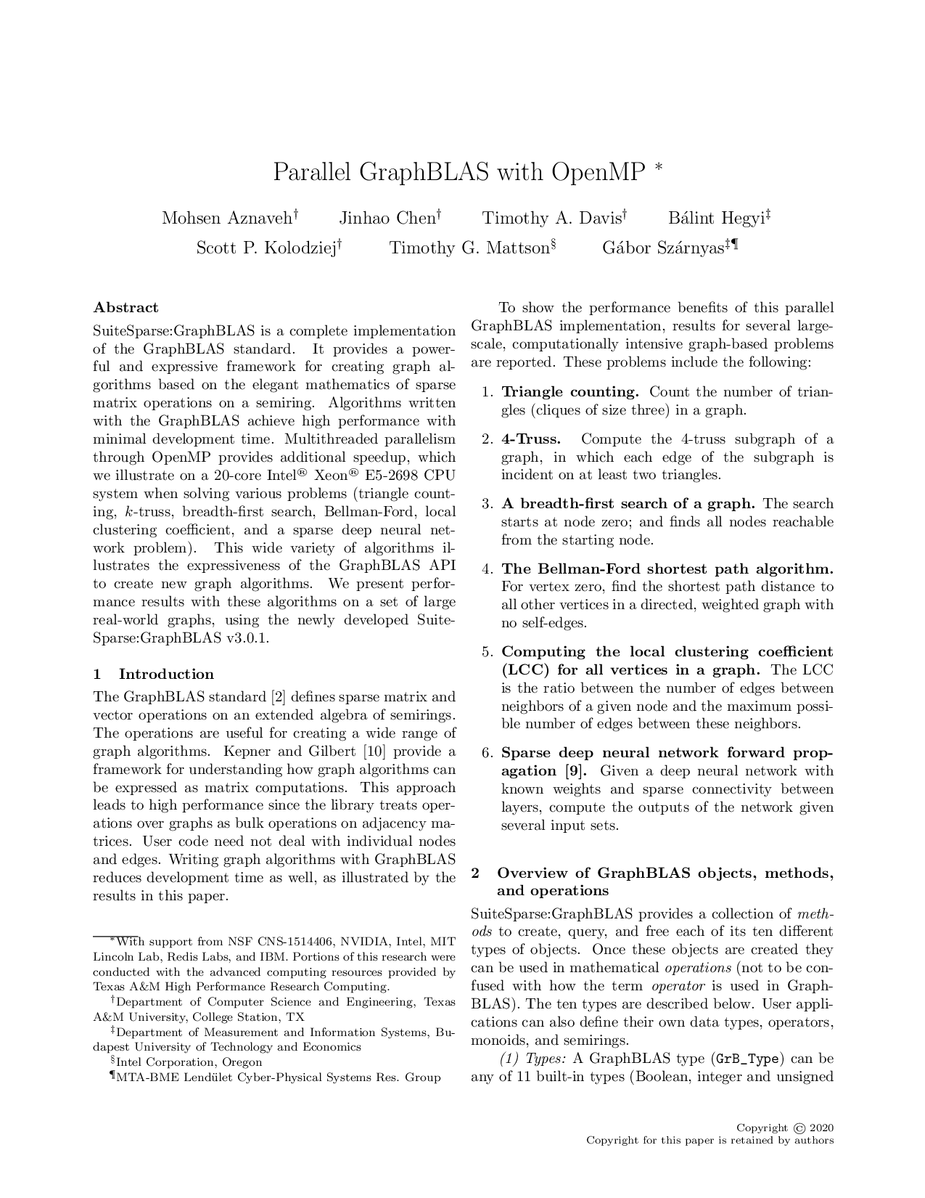
LCC: algorithm
Input: adjacency matrix $A$
Output: vector $lcc$
Workspace: matrix $TRI$, vectors $tri2$, $deg$, $wed$, and $lcc$
$TRI\left\langle A\right\rangle =A⊕.⊗A$ compute triangle count matrix
$tri2=\left[⊕_{j}TRI\left(:,j\right)\right]$ reduce to triangle count vector
$deg=\left[⊕_{j}A\left(:,j\right)\right]$ reduce to vertex degree vector
$wed=\text{perm}\text{2}\left(deg\right)$ apply perm2 to get wedge count vector
$lcc=tri2⊘wed$ LCC vector
M. Aznaveh, J. Chen, T.A. Davis, B. Hegyi, S.P. Kolodziej, T.G. Mattson, G. Szárnyas: Parallel GraphBLAS with OpenMP, Workshop on Combinatorial Scientific Computing 2020

Slide 17
LCC: Further optimizations
Further optimization: use $L$, the lower triangular part of $A$.
$$TRI\left\langle A\right\rangle =A⊕.⊗L$$
The number of wedges is now the 2-combination of $deg$.
$$\text{comb}\text{2}\left(x\right)=\frac{x⋅\left(x−1\right)}{2}$$
Permuting the adjacency matrix allows further optimizations.

Slide 18
LCC example: lower triangular part of mx.
1.00
0.50
$$TRI\left\langle A\right\rangle =A⊕.⊗L$$
①
②
$$L$$ | ① | ② | ③ | ④ | ⑤ | ⑥ | ⑦
①
② | 1
③
④ | 1 | 1 | 1
⑤ |  | 1
⑥ |  |  | 1 | 1 | 1
⑦ |  | 1 | 1 | 1 | 1
$$deg$$
2
4
3
5
3
3
4
0.40
④
⑦
0.50
⑤
0.33
$$\left[⊕_{j}⋯\right]$$
$$\text{comb}\text{2}\left( ⋯\right)$$
③
⑥
0.33
0.67
$$A$$ | ① | ② | ③ | ④ | ⑤ | ⑥ | ⑦
① |  | 1 |  | 1
② | 1 |  |  | 1 | 1 |  | 1
③ |  |  |  | 1 |  | 1 | 1
④ | 1 | 1 | 1 |  |  | 1 | 1
⑤ |  | 1 |  |  |  | 1 | 1
⑥ |  |  | 1 | 1 | 1
⑦ |  | 1 | 1 | 1 | 1
 | 1
1 |  |  | 1 | 1
 |  |  | 2
1 | 1 | 2
 | 1
 |  | 1
 | 2 | 1
$$tri$$
1
3
2
4
1
1
3
$$wed$$
1
6
3
10
3
3
6
$$lcc$$
1.00
0.50
0.67
0.40
0.33
0.33
0.50
$$\left[⊕_{j}⋯\right]$$
$$⊘$$
$$=$$

Slide 19
Graph algorithms in GraphBLAS
Triangle count / Cohen’s algorithm

Slide 20
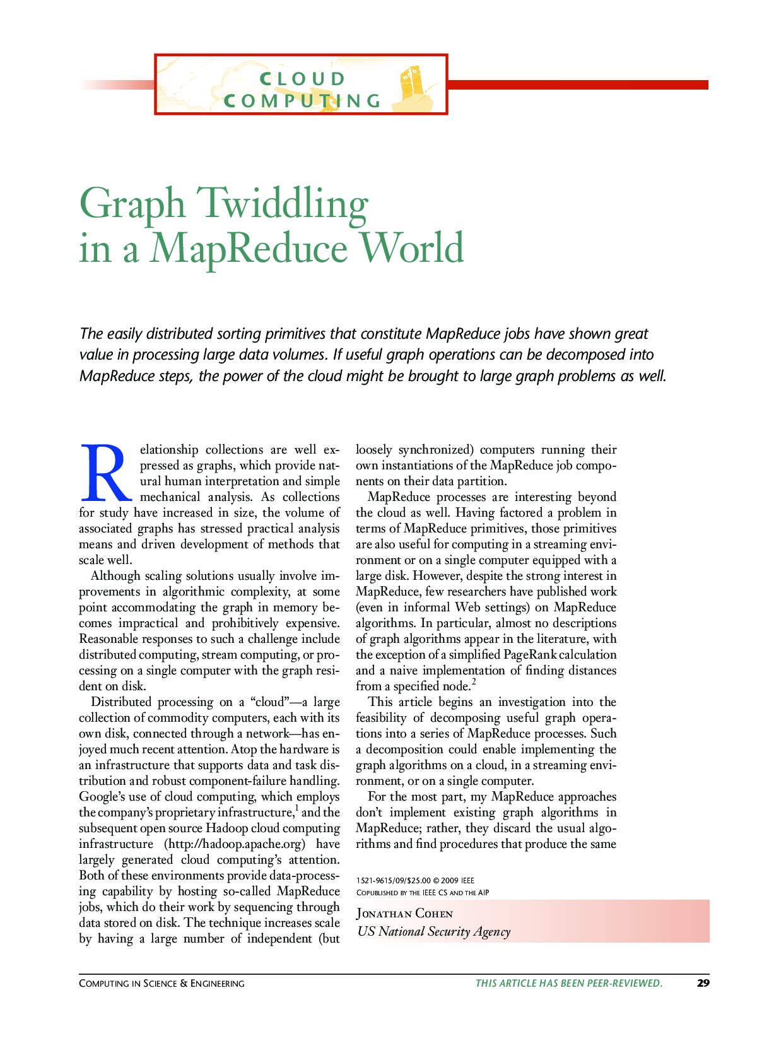
Cohen’s algorithm: pseudocode
Input: adjacency matrix $A$
Output: triangle count $t$
Workspace: matrices $L$, $U$, $B$, $C$
$L=tril\left(A\right)$ extract the lower triangle from A
$U=triu(A)$ extract the upper triangle from A
$B=L⊕.⊗U$ multiply matrices L and U
$C=B⊗A$ element-wise multiplication
$t=\sum{C}/2$ sum the values in C and divide by 2
J. Cohen: Graph Twiddling in a MapReduce World, Comput. Sci. Eng. 2009

Slide 21
Cohen’s algorithm
①
②
$$U$$ | ① | ② | ③ | ④ | ⑤ | ⑥ | ⑦
① |  | 1 |  | 1
② |  |  |  | 1 | 1 |  | 1
③ |  |  |  | 1 |  | 1 | 1
④ |  |  |  |  |  | 1 | 1
⑤ |  |  |  |  |  | 1 | 1
⑥
⑦
$$A$$ | ① | ② | ③ | ④ | ⑤ | ⑥ | ⑦
 |  | 1 |  | 1
 | 1 |  |  | 1 | 1 |  | 1
 |  |  |  | 1 |  | 1 | 1
 | 1 | 1 | 1 |  |  | 1 | 1
 |  | 1 |  |  |  | 1 | 1
 |  |  | 1 | 1 | 1
 |  | 1 | 1 | 1 | 1
④
⑦
⑤
$$⊗$$
③
⑥
$$L$$ | ① | ② | ③ | ④ | ⑤ | ⑥ | ⑦
①
② | 1
③
④ | 1 | 1 | 1
⑤ |  | 1
⑥ |  |  | 1 | 1 | 1
⑦ |  | 1 | 1 | 1 | 1
$B$
 |  | 1 |  | 1
 |  | 1 |  | 3 | 1 | 1 | 2
 |  |  |  | 1 | 1 |  | 1
 |  |  |  | 1 |  | 3 | 3
 |  |  |  | 2 | 1 | 3 | 4
$C$
 |  |  |  | 1
 |  | 1 |  |  |  | 1 | 2
 |  |  |  |  |  |  | 1
 |  |  |  | 1
 |  |  |  | 2 | 1
$t=\sum{C}/2$
Notes:
Julia code:
using LinearAlgebra
A = [0 1 0 1 0 0 0
1 0 0 1 1 0 1
0 0 0 1 0 1 1
1 1 1 0 0 1 1
0 1 0 0 0 1 1
0 0 1 1 1 0 0
0 1 1 1 1 0 0]
L = tril(A)
U = triu(A)
L*U.*A

Slide 22
Cohen’s algorithm: masking
①
②
$$U$$ | ① | ② | ③ | ④ | ⑤ | ⑥ | ⑦
① |  | 1 |  | 1
② |  |  |  | 1 | 1 |  | 1
③ |  |  |  | 1 |  | 1 | 1
④ |  |  |  |  |  | 1 | 1
⑤ |  |  |  |  |  | 1 | 1
⑥
⑦
④
⑦
⑤
③
⑥
$$L$$ | ① | ② | ③ | ④ | ⑤ | ⑥ | ⑦
①
② | 1
③
④ | 1 | 1 | 1
⑤ |  | 1
⑥ |  |  | 1 | 1 | 1
⑦ |  | 1 | 1 | 1 | 1
$C$
 |  |  |  | 1
 |  | 1 |  |  |  | 1 | 2
 |  |  |  |  |  |  | 1
 |  |  |  | 1
 |  |  |  | 2 | 1
$$C\left\langle A\right\rangle =L⊕.⊗U$$
$t=\sum{C}/2$

Slide 23
Graph algorithms in GraphBLAS
Triangle count / Sandia algorithm

Slide 24
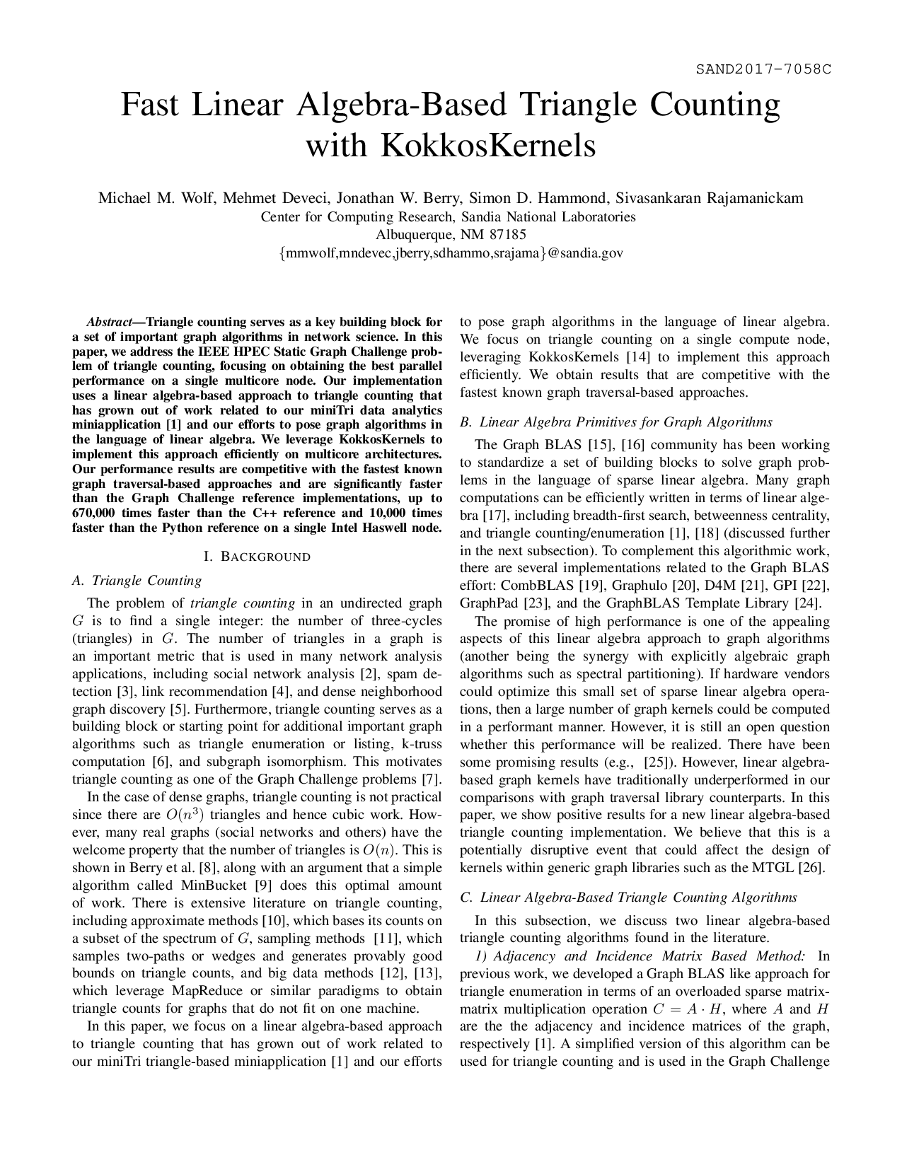
Sandia algorithm
Input: adjacency matrix $A$
Output: triangle count $t$
Workspace: matrices $L$, $U$, $B$, $C$
$L=tril\left(A\right)$ extract the lower triangle from A
$C\left\langle L\right\rangle =L⊕.⊗L$ multiply matrices L and L using mask L
$t=\sum{C}$ sum the values in C
M.M. Wolf et al. (Sandia National Laboratories): Fast linear algebra-based triangle counting with KokkosKernels, HPEC 2017

Slide 25
Sandia algorithm
①
②
$$L$$ | ① | ② | ③ | ④ | ⑤ | ⑥ | ⑦
①
② | 1
③
④ | 1 | 1 | 1
⑤ |  | 1
⑥ |  |  | 1 | 1 | 1
⑦ |  | 1 | 1 | 1 | 1
④
⑦
⑤
③
⑥
$$L$$ | ① | ② | ③ | ④ | ⑤ | ⑥ | ⑦
①
② | 1
③
④ | 1 | 1 | 1
⑤ |  | 1
⑥ |  |  | 1 | 1 | 1
⑦ |  | 1 | 1 | 1 | 1
$C$
 | 1
 |  |  | 1
 |  | 2 | 1
$$C\left\langle L\right\rangle =L⊕.⊗L$$
$t=\sum{C}$

Slide 26
Graph algorithms in GraphBLAS
Triangle count / CMU algorithm

Slide 27
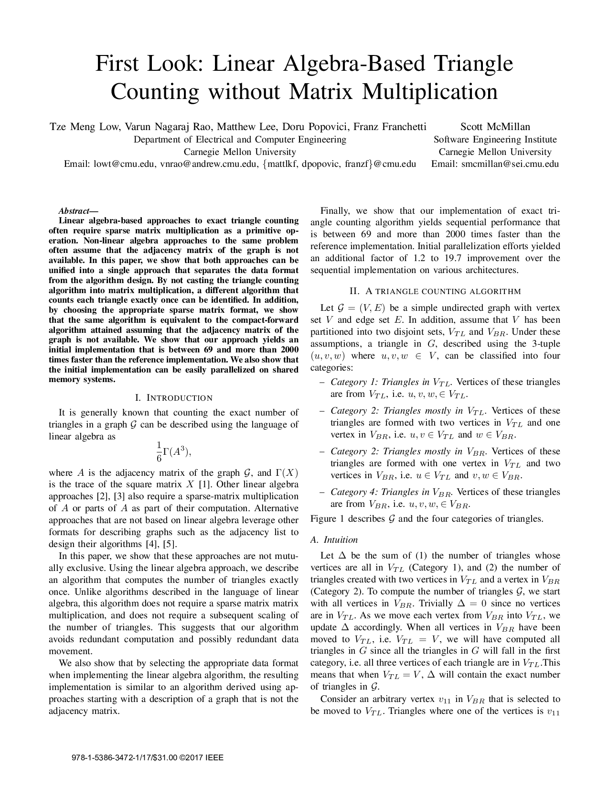
CMU algorithm
$$A$$ |  |  | $$i$$
 | $$A_{00}$$ |  | $$a_{01}$$ | $$A_{20}^{⊤}$$
$$i$$ | $$a_{01}^{⊤}$$ |  | 0 | $$a_{21}^{⊤}$$
 | $$A_{20}$$ |  | $$a_{21}$$ | $$A_{22}$$
Iterates on the vertices of the graph, extracts corresponding submatrices and computes $t=t+a_{10}^{⊤}⊕.⊗A_{20}⊕.⊗a_{12}$
Tradeoffs:
does not require mxm, only vxm and mxv
slower than mxm-based algorithms
The formula is derived using the matrix trace $tr\left(A\right)=\sum_{i=0}^{n−1 }{A_{ii}}$ and its invariant property under cyclic permutation, e.g. $tr\left(ABC\right)=tr\left(BCA\right)=tr\left(CAB\right)$. See the paper for details.
T.M. Low et al. (Carnegie Mellon University):
First look: linear algebra-based triangle counting without matrix multiplication, HPEC 2017

Slide 28
CMU algorithm: pseudocode
Input: adjacency matrix $A$
Output: triangle count $t$
Workspace: matrix $A_{20}$, $a_{10}$, $a_{12}^{⊤}$, $C$
$\text{for} i=2 \text{to} n−1$
$A_{20}=A\left[i+1:n, 0:i−1\right]$
$a_{10}=A\left[0:i−1, i\right]$
$a_{12}=A\left[i, i+1:n\right]$
$t=t+a_{10}^{⊤}⊕.⊗A_{20}⊕.⊗a_{12}$
$$A$$ |  |  | $$i$$
 | $$A_{00}$$ |  | $$a_{01}$$ | $$A_{20}^{⊤}$$
$$i$$ | $$a_{01}^{⊤}$$ |  | 0 | $$a_{21}^{⊤}$$
 | $$A_{20}$$ |  | $$a_{21}$$ | $$A_{22}$$
T.M. Low et al. (Carnegie Mellon University):
First look: linear algebra-based triangle counting without matrix multiplication, HPEC 2017

Slide 29
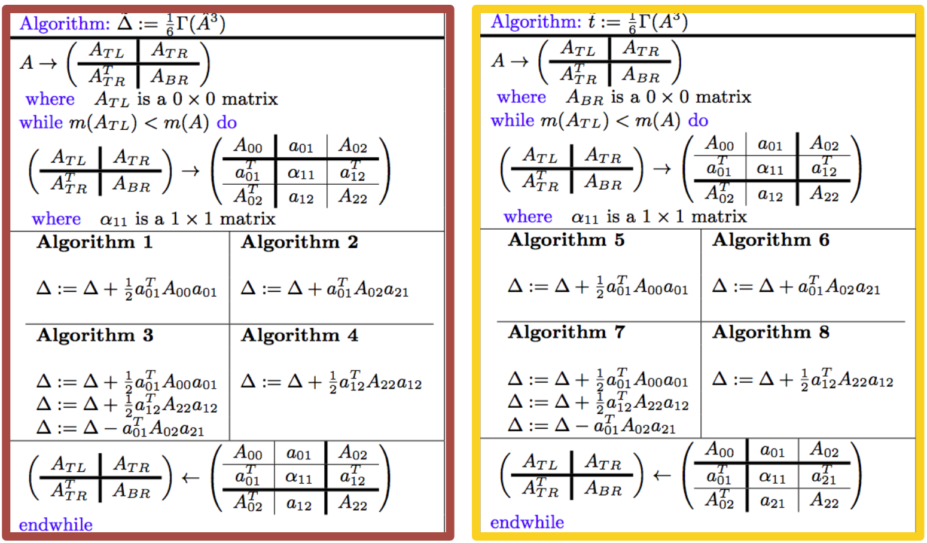
provably correct algorithms
The “CMU algorithm” belongs to a family of algorithms which can be derived using the “FLAME approach”.
There are 8 similar algorithms in total, the one presented here is Algorithm 2.
M. Lee, T.M. Low (Carnegie Mellon University):
A family of provably correct algorithms for exact triangle counting, CORRECTNESS @ SC 2017
Source of the figure

Slide 30
Graph algorithms in GraphBLAS
Vertex-wise triangle count

Slide 31
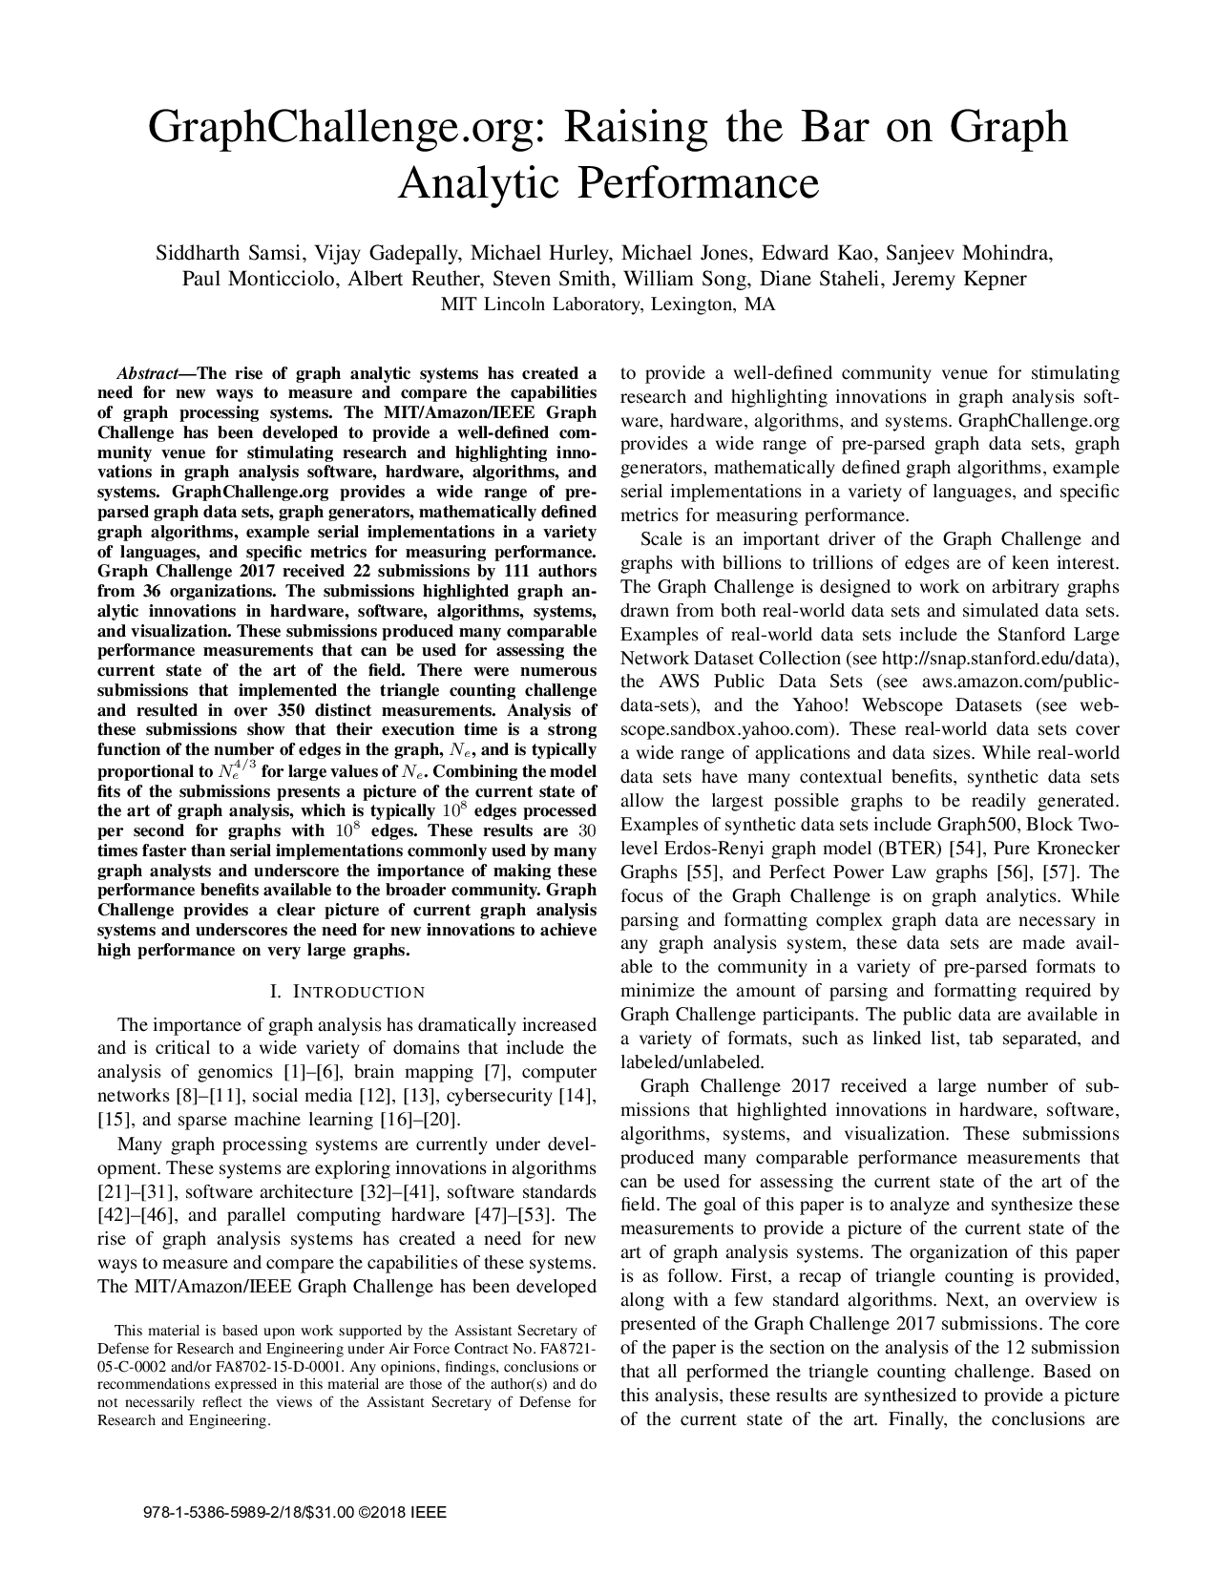
Vertex-Wise triangle count
Triangle – Def 1: a set of three mutually adjacent vertices.
Def 2: a three-length closed path.
Usages:
Global clustering coefficient
Local clustering coefficient
Finding communities
$$v$$
1
3
①
②
4
④
⑦
3
⑤
1
2
③
⑥
1
GraphChallenge.org: Raising the Bar on Graph Analytic Performance, HPEC 2018

Slide 32
TC: Element-wise multiplication
1
3
①
②
$$A$$ | ① | ② | ③ | ④ | ⑤ | ⑥ | ⑦
① |  | 1 |  | 1
② | 1 |  |  | 1 | 1 |  | 1
③ |  |  |  | 1 |  | 1 | 1
④ | 1 | 1 | 1 |  |  | 1 | 1
⑤ |  | 1 |  |  |  | 1 | 1
⑥ |  |  | 1 | 1 | 1
⑦ |  | 1 | 1 | 1 | 1
$$TRI=A⊕.⊗A⊗A \\ tri=\left[⊕_{j}TRI\left(:,j\right)\right]/2$$
$A⊕.⊗A$ is still very dense.
4
④
⑦
3
⑤
1
1
2
③
⑥
$$A$$ | ① | ② | ③ | ④ | ⑤ | ⑥ | ⑦
① |  | 1 |  | 1
② | 1 |  |  | 1 | 1 |  | 1
③ |  |  |  | 1 |  | 1 | 1
④ | 1 | 1 | 1 |  |  | 1 | 1
⑤ |  | 1 |  |  |  | 1 | 1
⑥ |  |  | 1 | 1 | 1
⑦ |  | 1 | 1 | 1 | 1
$$TRI$$
$$tri$$
2 | 1 | 1 | 1 | 1 | 1 | 2
1 | 4 | 2 | 2 | 1 | 2 | 2
1 | 2 | 3 | 2 | 2 | 1 | 1
1 | 2 | 2 | 5 | 3 | 1 | 2
1 | 1 | 2 | 3 | 3 |  | 1
1 | 2 | 1 | 1 |  | 3 | 3
2 | 2 | 1 | 2 | 1 | 3 | 4
 | 1 |  | 1
1 |  |  | 2 | 1 |  | 2
 |  |  | 2 |  | 1 | 1
1 | 2 | 2 |  |  | 1 | 2
 | 1 |  |  |  |  | 1
 |  | 1 | 1
 | 2 | 1 | 2 | 1
1
3
2
4
1
1
3
$⊗$ $A$
$$\left[⊕_{j}⋯\right]$$
$$/2$$

Slide 33
TC: Element-wise multiplication
1
3
①
②
$$A$$ | ① | ② | ③ | ④ | ⑤ | ⑥ | ⑦
① |  | 1 |  | 1
② | 1 |  |  | 1 | 1 |  | 1
③ |  |  |  | 1 |  | 1 | 1
④ | 1 | 1 | 1 |  |  | 1 | 1
⑤ |  | 1 |  |  |  | 1 | 1
⑥ |  |  | 1 | 1 | 1
⑦ |  | 1 | 1 | 1 | 1
Masking limits where the operation is computed. Here, we use $A$ as a mask for $A⊕.⊗A$.
4
④
⑦
3
⑤
1
$$TRI\left\langle A\right\rangle =A⊕.⊗A \\ tri=\left[⊕_{j}TRI\left(:,j\right)\right]/2$$
1
2
③
⑥
$$A$$ | ① | ② | ③ | ④ | ⑤ | ⑥ | ⑦
① |  | 1 |  | 1
② | 1 |  |  | 1 | 1 |  | 1
③ |  |  |  | 1 |  | 1 | 1
④ | 1 | 1 | 1 |  |  | 1 | 1
⑤ |  | 1 |  |  |  | 1 | 1
⑥ |  |  | 1 | 1 | 1
⑦ |  | 1 | 1 | 1 | 1
$$tri/2$$
 | 1 |  | 1
1 |  |  | 2 | 1 |  | 2
 |  |  | 2 |  | 1 | 1
1 | 2 | 2 |  |  | 1 | 2
 | 1 |  |  |  |  | 1
 |  | 1 | 1
 | 2 | 1 | 2 | 1
1
3
2
4
1
1
3
$$\left[⊕_{j}⋯\right]$$
$$/2$$

Slide 34
TC: algorithm
Input: adjacency matrix $A$
Output: vector $tri$
Workspace: matrix $TRI$
$TRI\left\langle A\right\rangle =A⊕.⊗A$ compute the triangle count matrix
$tri=\left[⊕_{j}TRI\left(:,j\right)\right]/2$ compute the triangle count vector
Optimization: use $L$, the lower triangular part of $A$ to avoid duplicates.
$$TRI\left\langle A\right\rangle =A⊕.⊗L$$
Worst-case optimal joins: There are deep theoretical connections between masked matrix multiplication and relational joins. It has been proven in 2013 that for the triangle query, binary joins always provide suboptimal runtime, which gave rise to new research on the family of worst-case optimal multi-way joins algorithms.

Slide 35
Graph algorithms in GraphBLAS
k-truss

Slide 36
k-truss
Definition: the k-truss is a subset of the graph with the same number of vertices, where each edge appears in at least $k−2$triangles in the original graph.

Slide 37
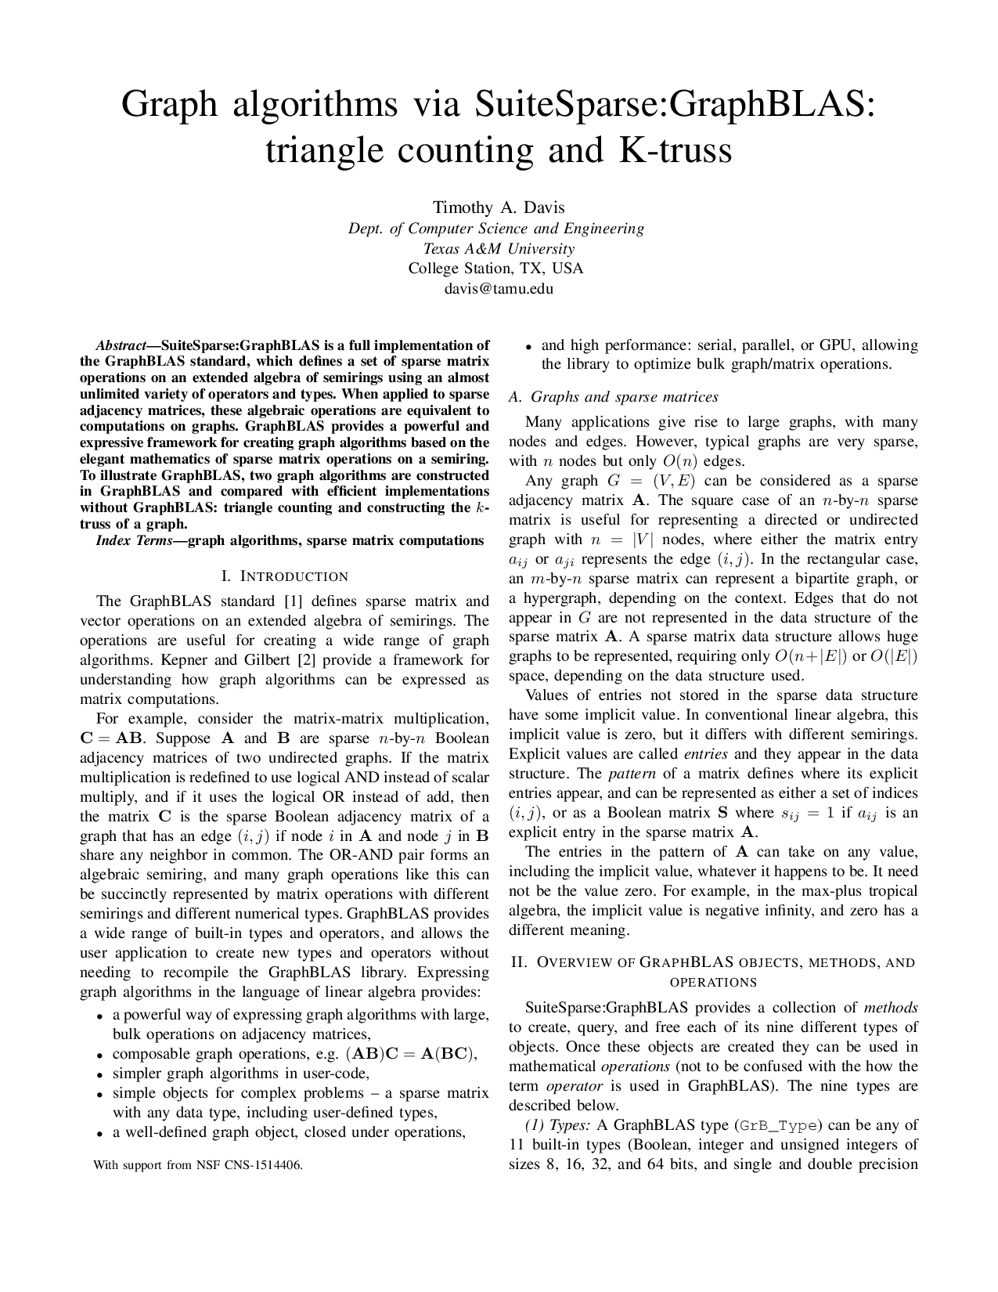
k-truss algorithm
Input: adjacency matrix $A$, scalar $k$
Output: $k$-truss adjacency matrix $C$
Helper: $f\left(x,support\right)=x≥support$
$C=A$
$\text{for} i=1 \text{to} n−1$
$C\left\langle C\right\rangle =C⊕. ∧C$ use the “plus-and” semiring
$C=f\left(C,k−2\right)$ drop entries in $C$ less than $k−2$
terminate if the number of non-zero values in $C$ did not change
TODO: clarify whether this is pattern/values/nvals
T.A. Davis: Graph algorithms via SuiteSparse:GraphBLAS: triangle counting and k-truss, HPEC 2018

Slide 38
Graph algorithms in GraphBLAS
Community detection using label propagation

Slide 39
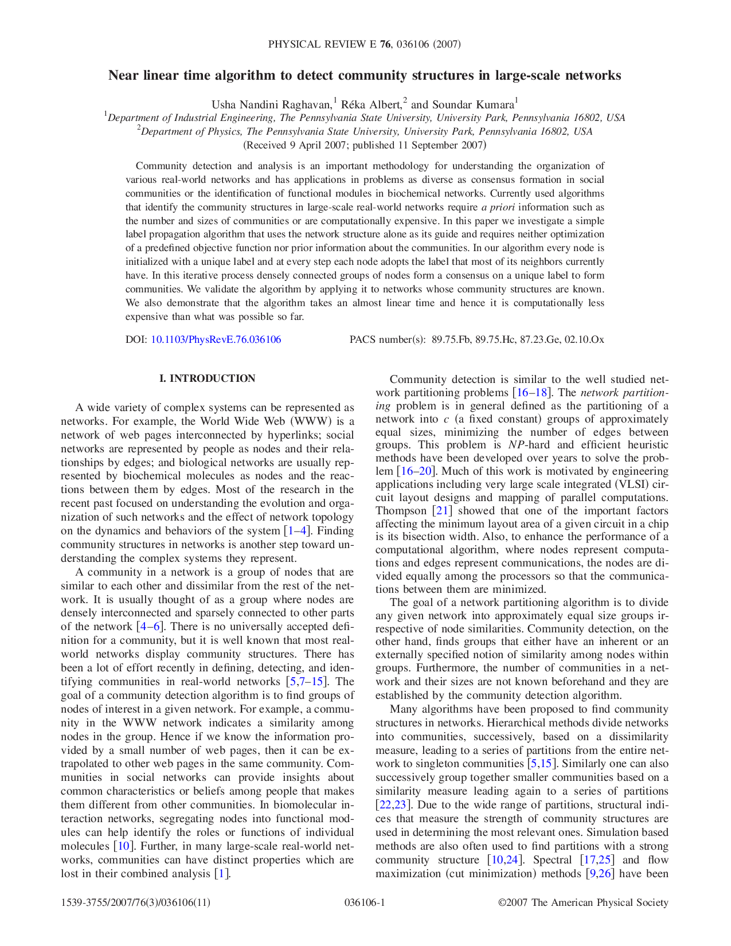
CDLP: Community Detection using Label Propagation
Goal: assign a label to each vertex representing the community it belongs to. The algorithm (originally published in network science) is slightly altered to ensure deterministic execution. Initially:
$$L_{0}\left(v\right)=v$$
In the $k^{th}$ iteration:
$$L_{k}\left(v\right)=\min\left(\arg{\max_{l}}\left|u∈N\left(v\right) | L_{k−1}\left(u\right)=l\right|\right),$$
where $N\left(v\right)$ is the set of neighbours of $v$.
Run for $t$ iterations or until reaching a fixed point.
U.N. Raghavan, R. Albert, S. Kumara: Near linear time algorithm to detect community structures in large-scale networks, Phys. Rev. E, 2007

Slide 40
Idea: capture CDLP in pure GraphBLAS
Define a semiring that operates over occurrence vectors
$⊕$ operator: combines two occurrence vectors
$\left\{6→1, 9→1\right\}⊕\left\{6→1, 7→2\right\}=\left\{6→2, 7→2, 9→1\right\}$
Convert each element in a row to an occurrence vector
$\left\{6→1\right\},\left\{6→1\right\},\left\{7→1\right\},\left\{7→1\right\},\left\{9→1\right\}$
Reduce each row into a single occurrence vector:
$\left\{6→2, 7→2, 9→1\right\}$
Select the min. mode element from the occurrence vector
6
Works on paper, but occurrence vectors need dynamic memory allocation, which leads to very poor performance

Slide 41
CDLP in linear algebra
Extract each row from $F$
Easy if the matrix is stored in CSR format
Select the minimum mode value in each row
Sort elements using parallel merge sort
Pick the min value that has the longest run (done in a single pass)
Sort each row $\text{r}$
Use the sorted list to compute $\text{mode}\text{(}\text{r}\text{)}$

Slide 42
CDLP Example
$diag\left(lab\right)$ |  | ① | ② | ③ | ④ | ⑤ | ⑥ | ⑦
 | ① | 1
 | ② |  | 2
 | ③ |  |  | 3
 | ④ |  |  |  | 4
 | ⑤ |  |  |  |  | 5
 | ⑥ |  |  |  |  |  | 6
 | ⑦ |  |  |  |  |  |  | 7
1
2
①
②
4
④
⑦
7
⑤
5
$$A$$ | ① | ② | ③ | ④ | ⑤ | ⑥ | ⑦
① |  | ● |  | ●
② | ● |  |  |  | ● |  | ●
③ |  |  |  | ● |  | ● | ●
④ | ● |  | ● |  |  |  | ●
⑤ |  | ● |  |  |  | ● | ●
⑥ |  |  | ● |  | ●
⑦ |  | ● | ● | ● | ●
 | 2 |  | 4
1 |  |  |  | 5 |  | 7
 |  |  | 4 |  | 6 | 7
1 |  | 3 |  |  |  | 7
 | 2 |  |  |  | 6 | 7
 |  | 3 |  | 5
 | 2 | 3 | 4 | 5
3
③
⑥
6
Initially, $lab=\left[1 2…n\right]$
Propagate labels to create a “frequency matrix”:
$$F=A \text{any}\text{.}\text{sel}\text{2}\text{nd} \text{diag}(lab)$$

Slide 43
CDLP Example
$diag\left(lab\right)$ |  | ① | ② | ③ | ④ | ⑤ | ⑥ | ⑦
 | ① | 1
 | ② |  | 2
 | ③ |  |  | 3
 | ④ |  |  |  | 4
 | ⑤ |  |  |  |  | 5
 | ⑥ |  |  |  |  |  | 6
 | ⑦ |  |  |  |  |  |  | 7
1
2
①
②
4
④
⑦
7
⑤
5
$$A$$ | ① | ② | ③ | ④ | ⑤ | ⑥ | ⑦
① |  | ● |  | ●
② | ● |  |  |  | ● |  | ●
③ |  |  |  | ● |  | ● | ●
④ | ● |  | ● |  |  |  | ●
⑤ |  | ● |  |  |  | ● | ●
⑥ |  |  | ● |  | ●
⑦ |  | ● | ● | ● | ●
$$lab′$$
 | 2 |  | 4
1 |  |  |  | 5 |  | 7
 |  |  | 4 |  | 6 | 7
1 |  | 3 |  |  |  | 7
 | 2 |  |  |  | 6 | 7
 |  | 3 |  | 5
 | 2 | 3 | 4 | 5
2
1
4
1
2
3
2
3
③
⑥
6
min. mode
step: 1

Slide 44
CDLP Example
$diag\left(lab\right)$ |  | ① | ② | ③ | ④ | ⑤ | ⑥ | ⑦
 | ① | 2
 | ② |  | 1
 | ③ |  |  | 4
 | ④ |  |  |  | 1
 | ⑤ |  |  |  |  | 2
 | ⑥ |  |  |  |  |  | 3
 | ⑦ |  |  |  |  |  |  | 2
2
1
①
②
1
④
⑦
2
⑤
2
$$A$$ | ① | ② | ③ | ④ | ⑤ | ⑥ | ⑦
① |  | ● |  | ●
② | ● |  |  |  | ● |  | ●
③ |  |  |  | ● |  | ● | ●
④ | ● |  | ● |  |  |  | ●
⑤ |  | ● |  |  |  | ● | ●
⑥ |  |  | ● |  | ●
⑦ |  | ● | ● | ● | ●
$$lab′$$
 | 1 |  | 1
2 |  |  |  | 2 |  | 2
 |  |  | 1 |  | 3 | 2
2 |  | 4 |  |  |  | 2
 | 1 |  |  |  | 3 | 2
 |  | 4 |  | 2
 | 1 | 4 | 1 | 2
1
2
1
2
1
2
1
4
③
⑥
3
min. mode
step: 2

Slide 45
CDLP Example
$diag\left(lab\right)$ |  | ① | ② | ③ | ④ | ⑤ | ⑥ | ⑦
 | ① | 1
 | ② |  | 2
 | ③ |  |  | 1
 | ④ |  |  |  | 2
 | ⑤ |  |  |  |  | 1
 | ⑥ |  |  |  |  |  | 2
 | ⑦ |  |  |  |  |  |  | 1
1
2
①
②
2
④
⑦
1
⑤
1
$$A$$ | ① | ② | ③ | ④ | ⑤ | ⑥ | ⑦
① |  | ● |  | ●
② | ● |  |  |  | ● |  | ●
③ |  |  |  | ● |  | ● | ●
④ | ● |  | ● |  |  |  | ●
⑤ |  | ● |  |  |  | ● | ●
⑥ |  |  | ● |  | ●
⑦ |  | ● | ● | ● | ●
$$lab′$$
 | 2 |  | 2
1 |  |  |  | 1 |  | 1
 |  |  | 2 |  | 2 | 1
1 |  | 1 |  |  |  | 1
 | 2 |  |  |  | 2 | 1
 |  | 1 |  | 1
 | 2 | 1 | 2 | 1
2
1
2
1
2
1
1
1
③
⑥
2
min. mode
step: 3

Slide 46
CDLP Example
$diag\left(lab\right)$ |  | ① | ② | ③ | ④ | ⑤ | ⑥ | ⑦
 | ① | 2
 | ② |  | 1
 | ③ |  |  | 2
 | ④ |  |  |  | 1
 | ⑤ |  |  |  |  | 2
 | ⑥ |  |  |  |  |  | 1
 | ⑦ |  |  |  |  |  |  | 1
2
1
①
②
1
④
⑦
1
⑤
2
$$A$$ | ① | ② | ③ | ④ | ⑤ | ⑥ | ⑦
① |  | ● |  | ●
② | ● |  |  |  | ● |  | ●
③ |  |  |  | ● |  | ● | ●
④ | ● |  | ● |  |  |  | ●
⑤ |  | ● |  |  |  | ● | ●
⑥ |  |  | ● |  | ●
⑦ |  | ● | ● | ● | ●
$$lab′$$
 | 1 |  | 1
2 |  |  |  | 2 |  | 1
 |  |  | 1 |  | 1 | 1
2 |  | 2 |  |  |  | 1
 | 1 |  |  |  | 1 | 1
 |  | 2 |  | 2
 | 1 | 2 | 1 | 2
1
2
1
2
1
2
1
2
③
⑥
1
min. mode
step: 4
same result as in step 2

Slide 47
CDLP: algorithm
Input: adjacency matrix $A$, #vertices $n$, #iterations $t$
Output: vector $lab$
Workspace: matrix $\text{F}$, vector $r$
$lab=\left[1 2…n\right]$
$for k=1 \text{to} t$
$F=A \text{any}\text{.}\text{sel}\text{2}\text{nd} \text{diag}\left(lab\right)$
$\text{for} i=1 \text{to} n$
$r=F\left(i,:\right)$
$sort\left(r\right)$
$lab\left(i\right)=select_min_mode\left(r\right)$
Can be batched and parallelized

Slide 48
CDLP: algorithm
Input: adjacency matrix $A$, #vertices $n$, #iterations $t$
Output: vector $lab$
Workspace: matrix $\text{F}$, vector $r$, array of row indices $I$, array of values $X$
$lab=\left[1 2…n\right]$
$for k=1 \text{to} t$
$F=A \text{any}\text{.}\text{sel}\text{2}\text{nd} \text{diag}\left(lab\right)$
$〈I, _,X〉=extract_tuples(F)$
$merge_sort_pairs\left(〈I, X〉\right)$
$lab=$for each row in $I$, select min mode value from $X$

Slide 49
CDLP on directed graphs
For directed graphs, we compute the labels $L_{k}\left(v\right)$ as:
$$\min\left(\arg{\max_{l}}\left[\left|u∈N_{in}\left(v\right) | L_{k−1}\left(u\right)=l\right|+\left|u∈N_{out}\left(v\right) | L_{k−1}\left(u\right)=l\right|\right]\right)$$
In linear algebra, this can be expressed with two matrices:
$F_{in}=A any.sel2nd \text{diag}\left(lab\right)$
$F_{out}=A^{⊤} any.sel2nd \text{diag}\left(lab\right)$
Simultaneously iterate over rows $r_{in}$ of $F_{in}$ and $r_{out}$ of $F_{out}$
For each row pair, sort $r_{in}∪r_{out}$ and select the minimum mode value
Batching also works:
$〈I_{in}, _,X_{in}〉=extract_tuples\left(F_{in}\right)$
$〈I_{out}, _,X_{out}〉=extract_tuples\left(F_{out}\right)$
$$merge_sort_pairs\left(〈I_{in}∪I_{out}, X_{in}∪X_{out}〉\right)$$

Slide 50
Graph algorithms in GraphBLAS
Other algorithms

Slide 51
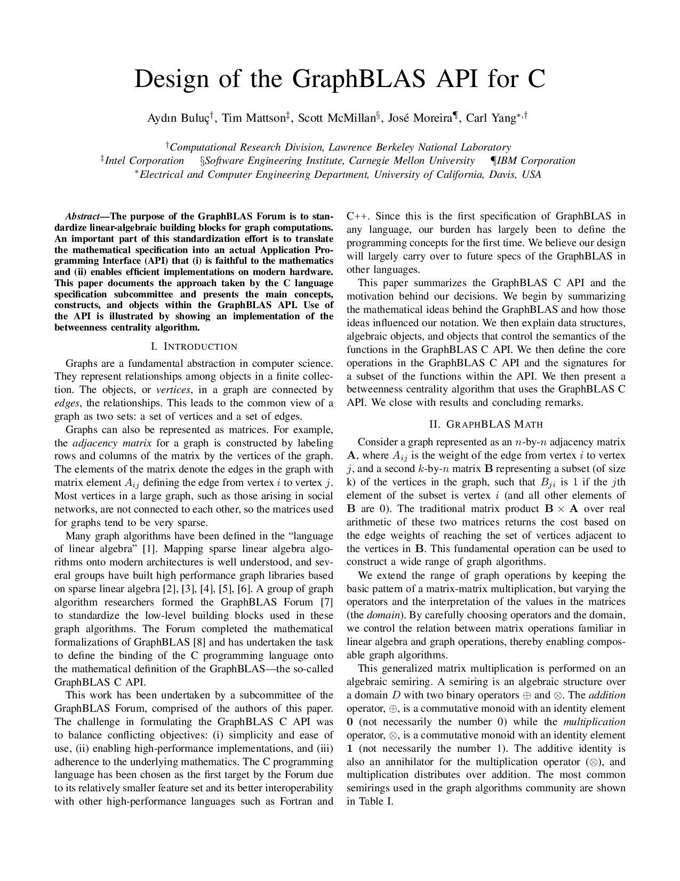
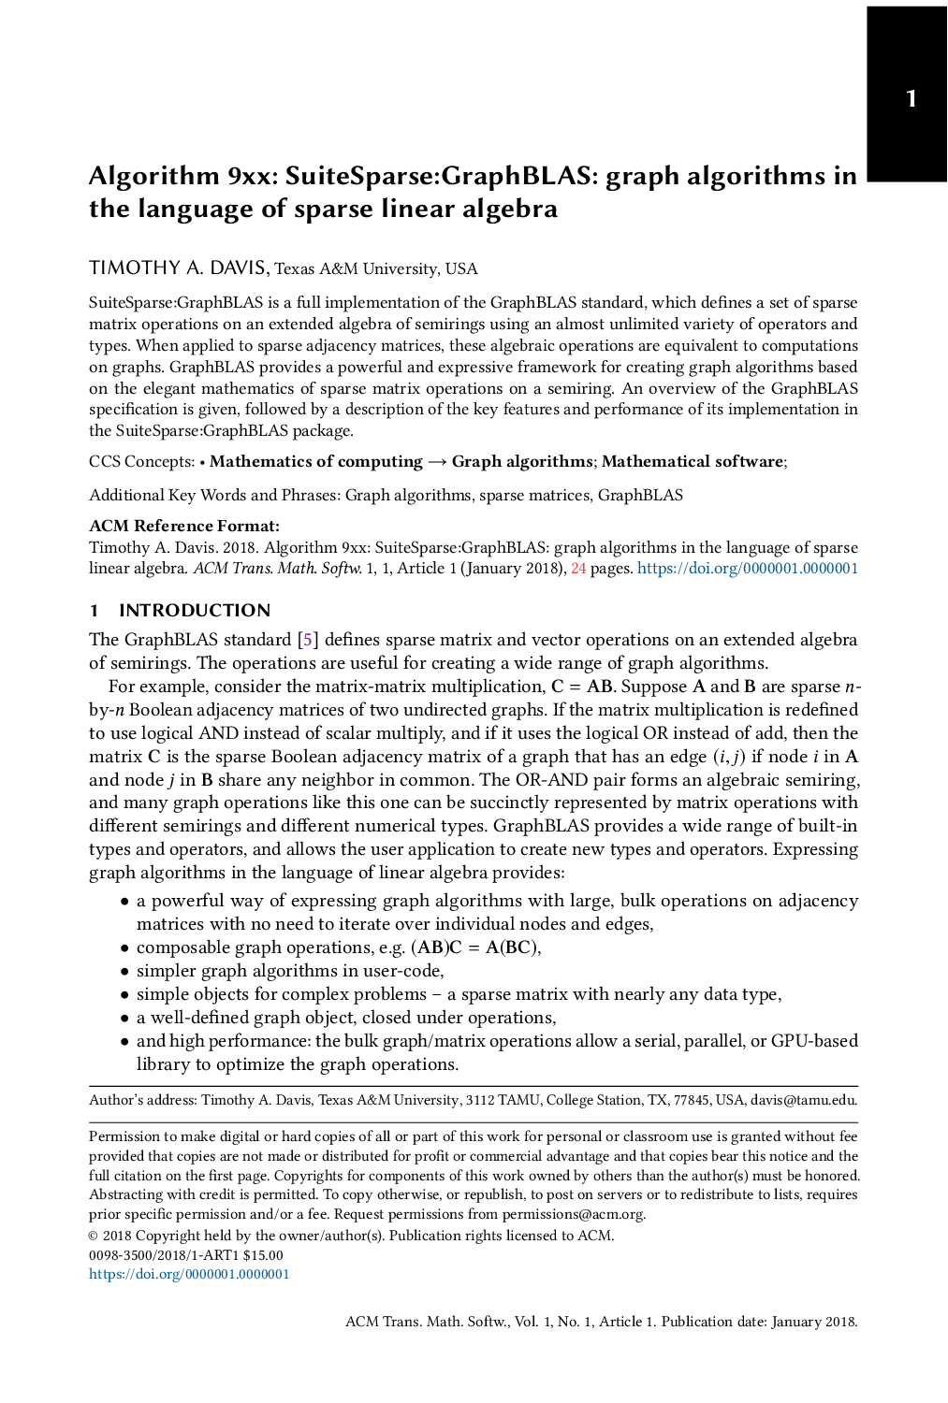
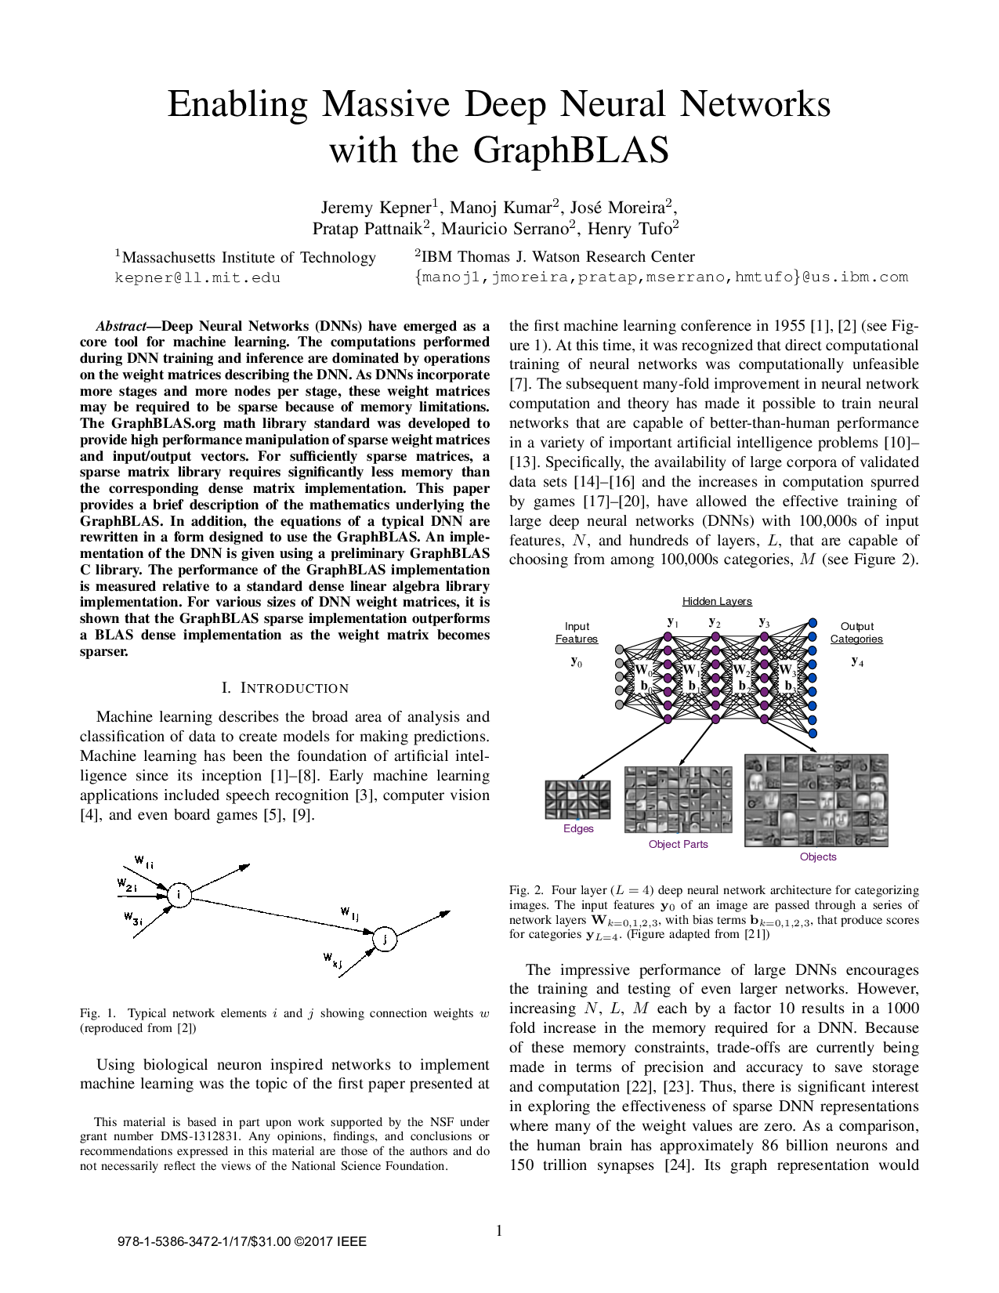
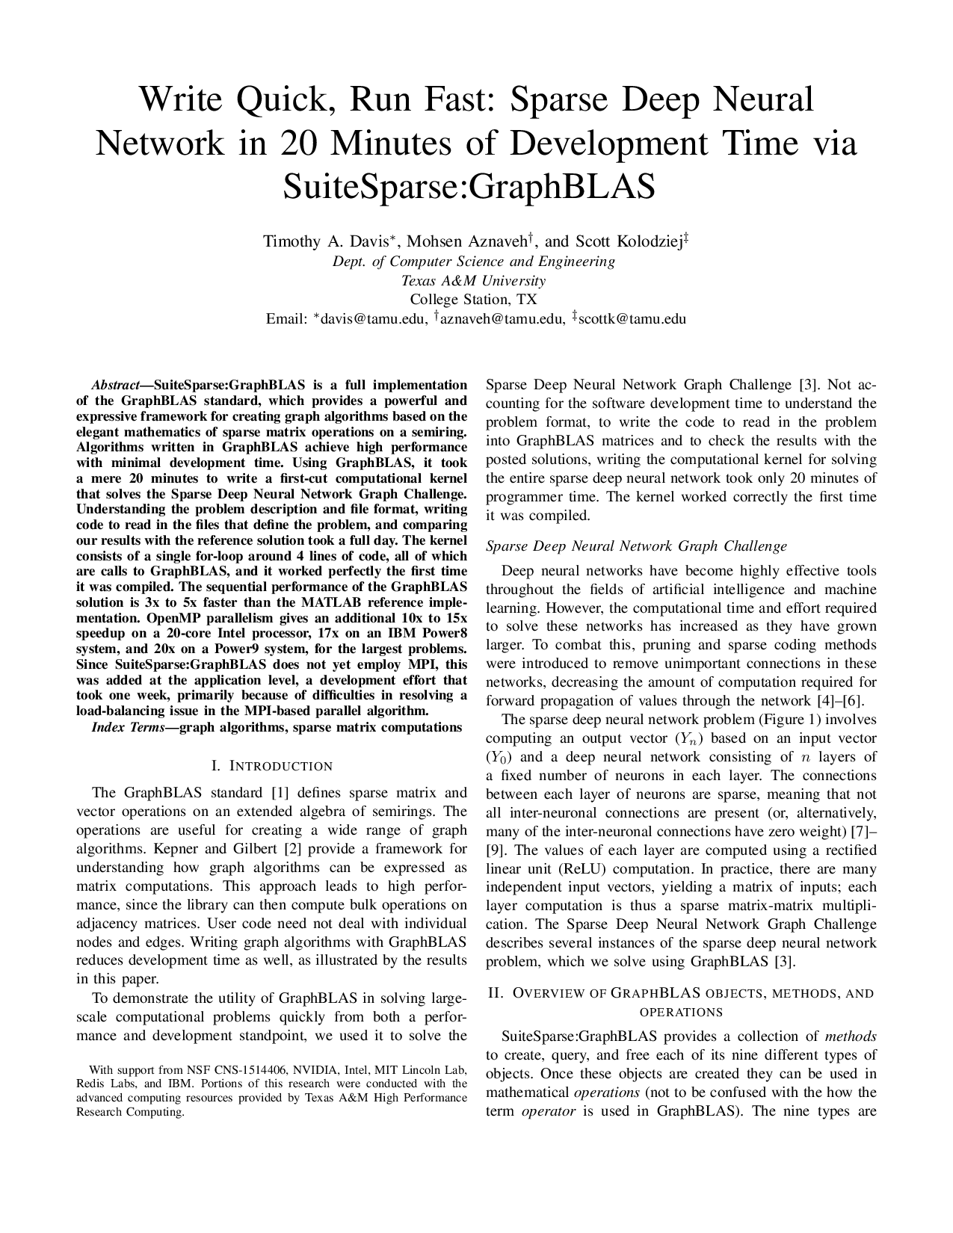
Other algorithms in GraphBLAS
Betweenness centrality: Brandes’ algorithm
A. Buluç et al.: Design of the GraphBLAS C API, GABB@IPDPS 2017
k-truss: a subset of the graph with the same number of vertices, where each edge appears in at least $k−2$triangles in the original graph.
T.A. Davis: Graph algorithms via SuiteSparse:GraphBLAS: triangle counting and k-truss, HPEC 2018
Maximal independent set: Luby’s randomized algorithm
T.A. Davis: Algorithm 1000: SuiteSparse:GraphBLAS: graph algorithms in the language of sparse linear algebra, ACM TOMS, 2019
Sparse DNNs: represent sparse deep neural networks as graphs
T.A. Davis et al.: Write Quick, Run Fast: Sparse Deep Neural Network in 20 Minutes of Development Time via SuiteSparse:GraphBLAS, HPEC 2019
J. Kepner et al.: Enabling Massive Deep Neural Networks with the GraphBLAS, HPEC 2017

Slide 52
Graph algorithms in GraphBLAS
Weakly connected components

Slide 53
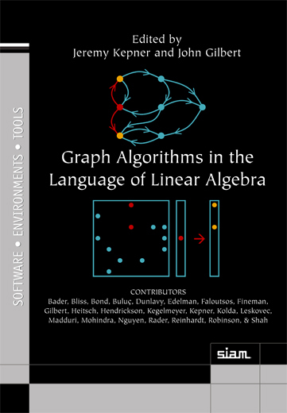
WCC: Weakly Connected Components (sketch)
$$C=I∨A∨A^{2}∨A^{3}∨A^{4}∨… \\ D=I+A+A^{2}+A^{3}+A^{4}∨…∨A^{K} \\ E≡\left(I−A\right)D \\ E=D−AD \\ =I+A+A^{2}+A^{3}+A^{4}+…−A−A^{2}−A^{3}−A^{4}−… \\ =I \\ =\left(I−A\right)D \\ D={\left(I−A\right)}^{−1}$$
J. Kepner, J.R. Gilbert: Graph Algorithms in the Language of Linear Algebra, Chapter 3, SIAM, 2011

Slide 54
WCC: Weakly Connected Components
The series for $D$ does usually not converge. However, by replacing $A$ with $αA$, where $α$ is a sufficiently small positive number, the series converges. The derivation presented in the previous slide is still valid, resulting in ${D=\left(I−αA\right)}^{−1}$.
While this trick ensures that the presented algorithm works correctly, this approach is still impractical as it computes the inverse of a sparse matrix which is dense in most cases.

Slide 55
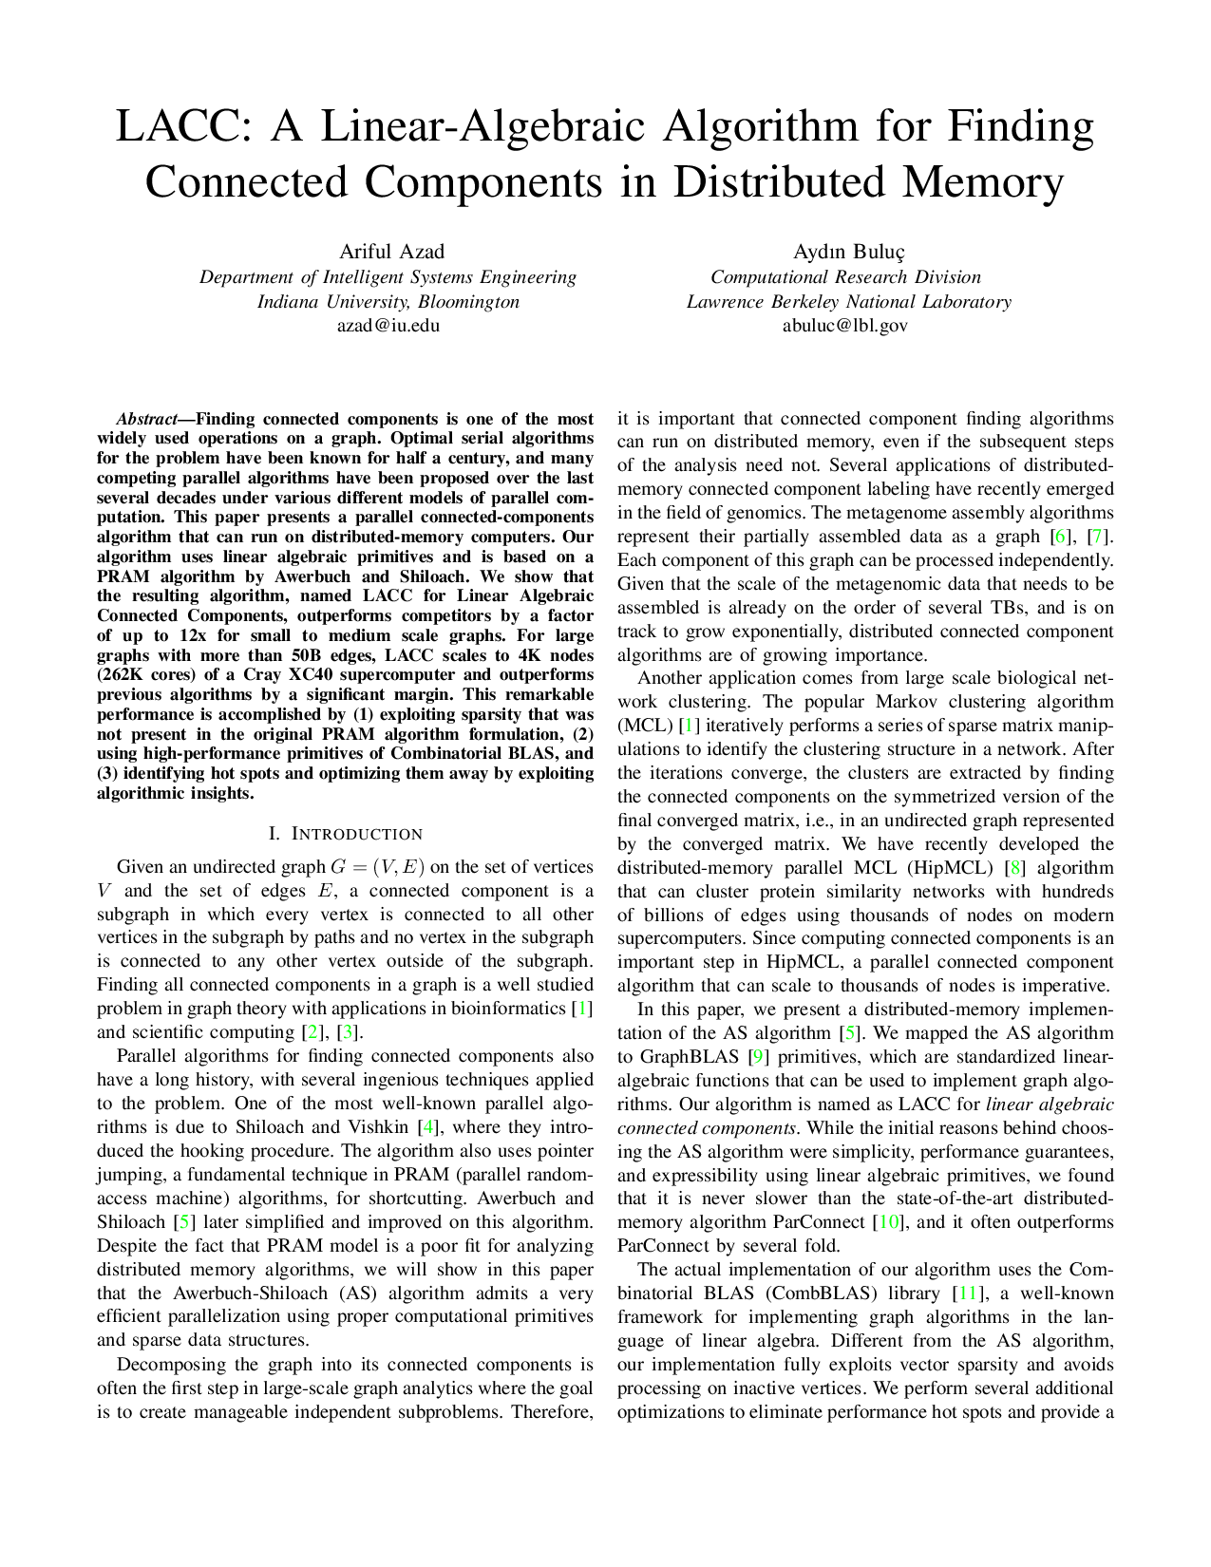
WCC: Weakly Connected Components
Linear Algebraic Connected Components algorithm (LACC)
Recent result, based on the Awerbuch-Shiloach algorithm.
Designed for supercomputers, scales to 250,000+ CPU cores.
“Distributed-memory LACC code that is used in our experiments is publicly available as part of the CombBLAS library. A simplified unoptimized serial GraphBLAS implementation is also committed to the LAGraph Library for educational purposes.”
See also FastSV.
A. Azad, A. Buluç: LACC: A Linear-Algebraic Algorithm for Finding Connected Components in Distributed Memory, IPDPS 2019

Slide 56
Graph algorithms in GraphBLAS
Maximal independent set: Luby’s algorithm

Slide 57
Luby’s algorithm
To be done later.

Slide 58
Push/pull BFS in GraphBLAS

Slide 59
Direction-optimizing traversal
This optimization is subject to future work.
For low diameter graphs, it is worth using push/pull phases
Push/pull is simple to express in GraphBLAS
See [Yang et al., ICPP’18], [Yang et al., preprint’19]
But deciding when to change is non-trivial
push
push
pull
Notes:
Improve loading time
Optimize Q1
Filter for frequent communications on-the-fly

Slide 60
$$Ω$$

